Slide 1









Phyton For
Data science
using jupyterlab
By muhammad haidi nurrahman

Slide 2


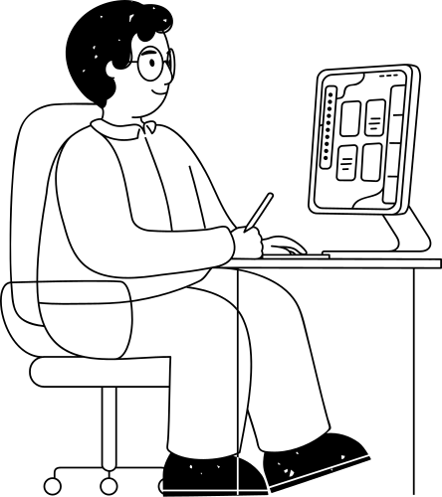



TABLE OF CONTENT
01
02
03
Data Set
Data Preparation
Code and Visualization

Slide 3






DATA SET

Slide 4

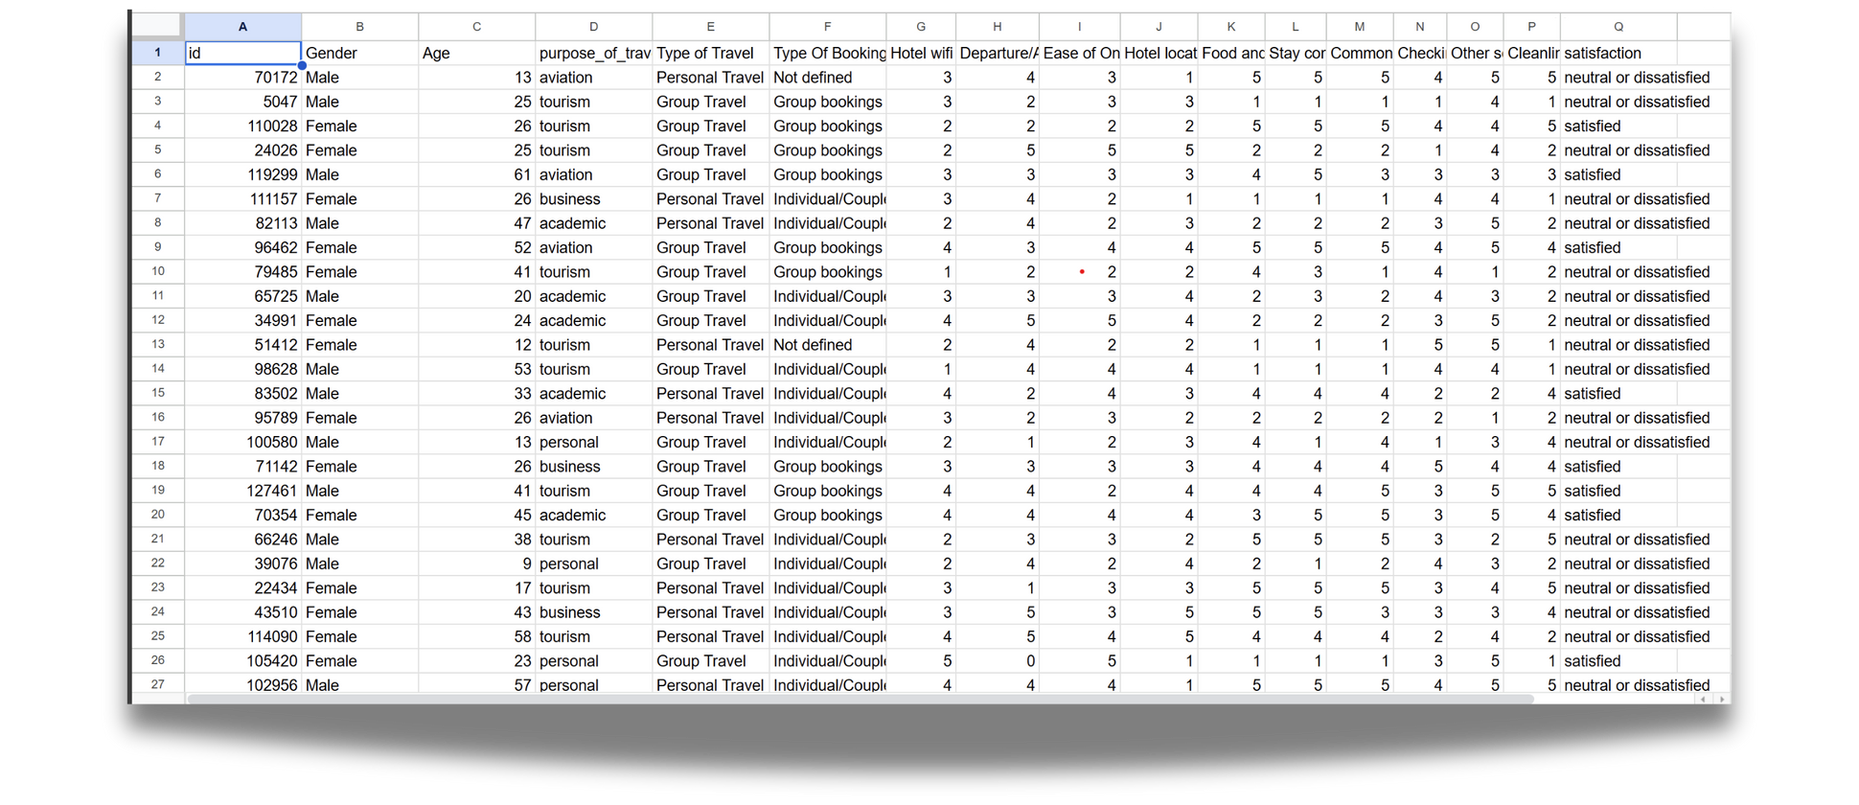


for the data that I will use are
Europe Hotel Booking Satisfaction Score.csv

Slide 5
DATA PREPARATION

Slide 6
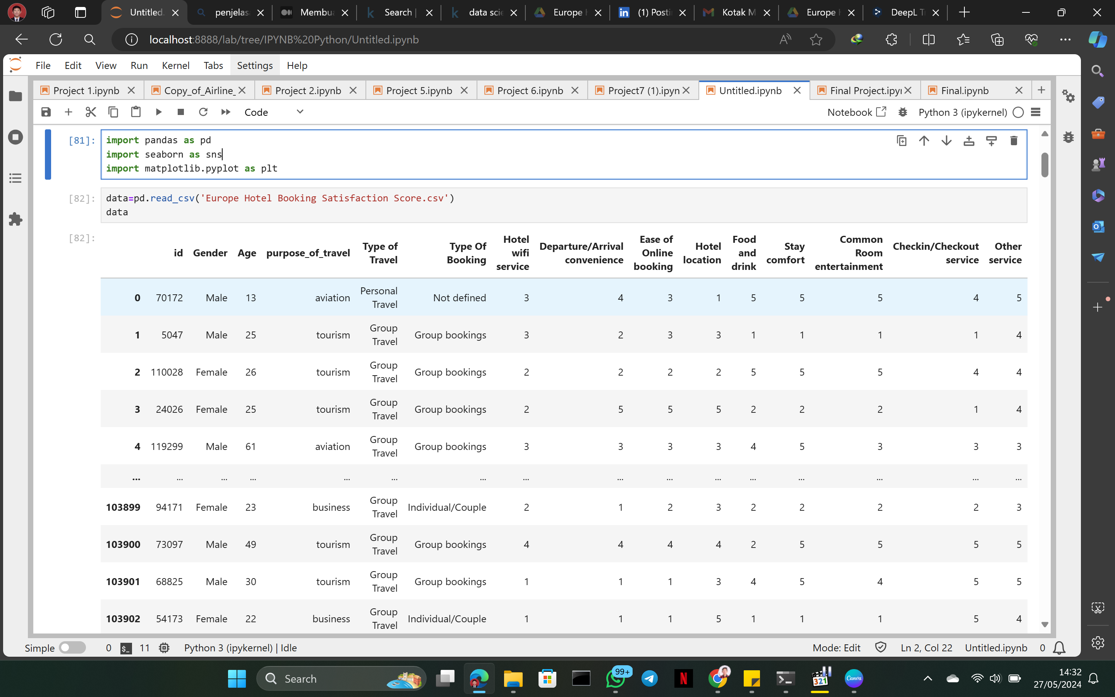

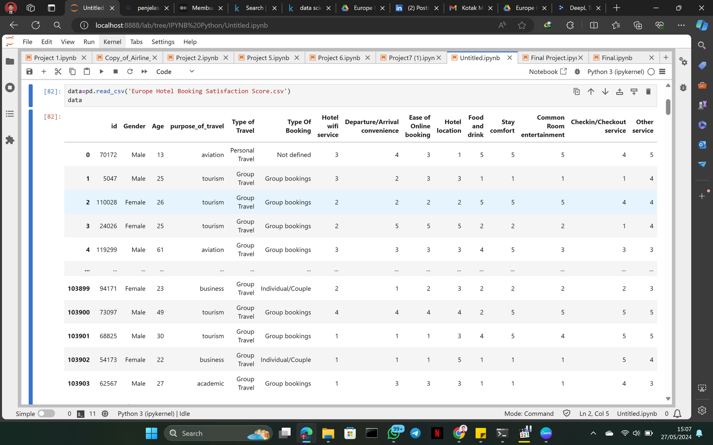
Load Data
importing 3 libraries : pandas, seaborn, matplotlib.pyplot
after that we can load the data with the name 'Europe Hotel Booking Satisfaction Score.csv'
then we can display the contents of the data set

Slide 7
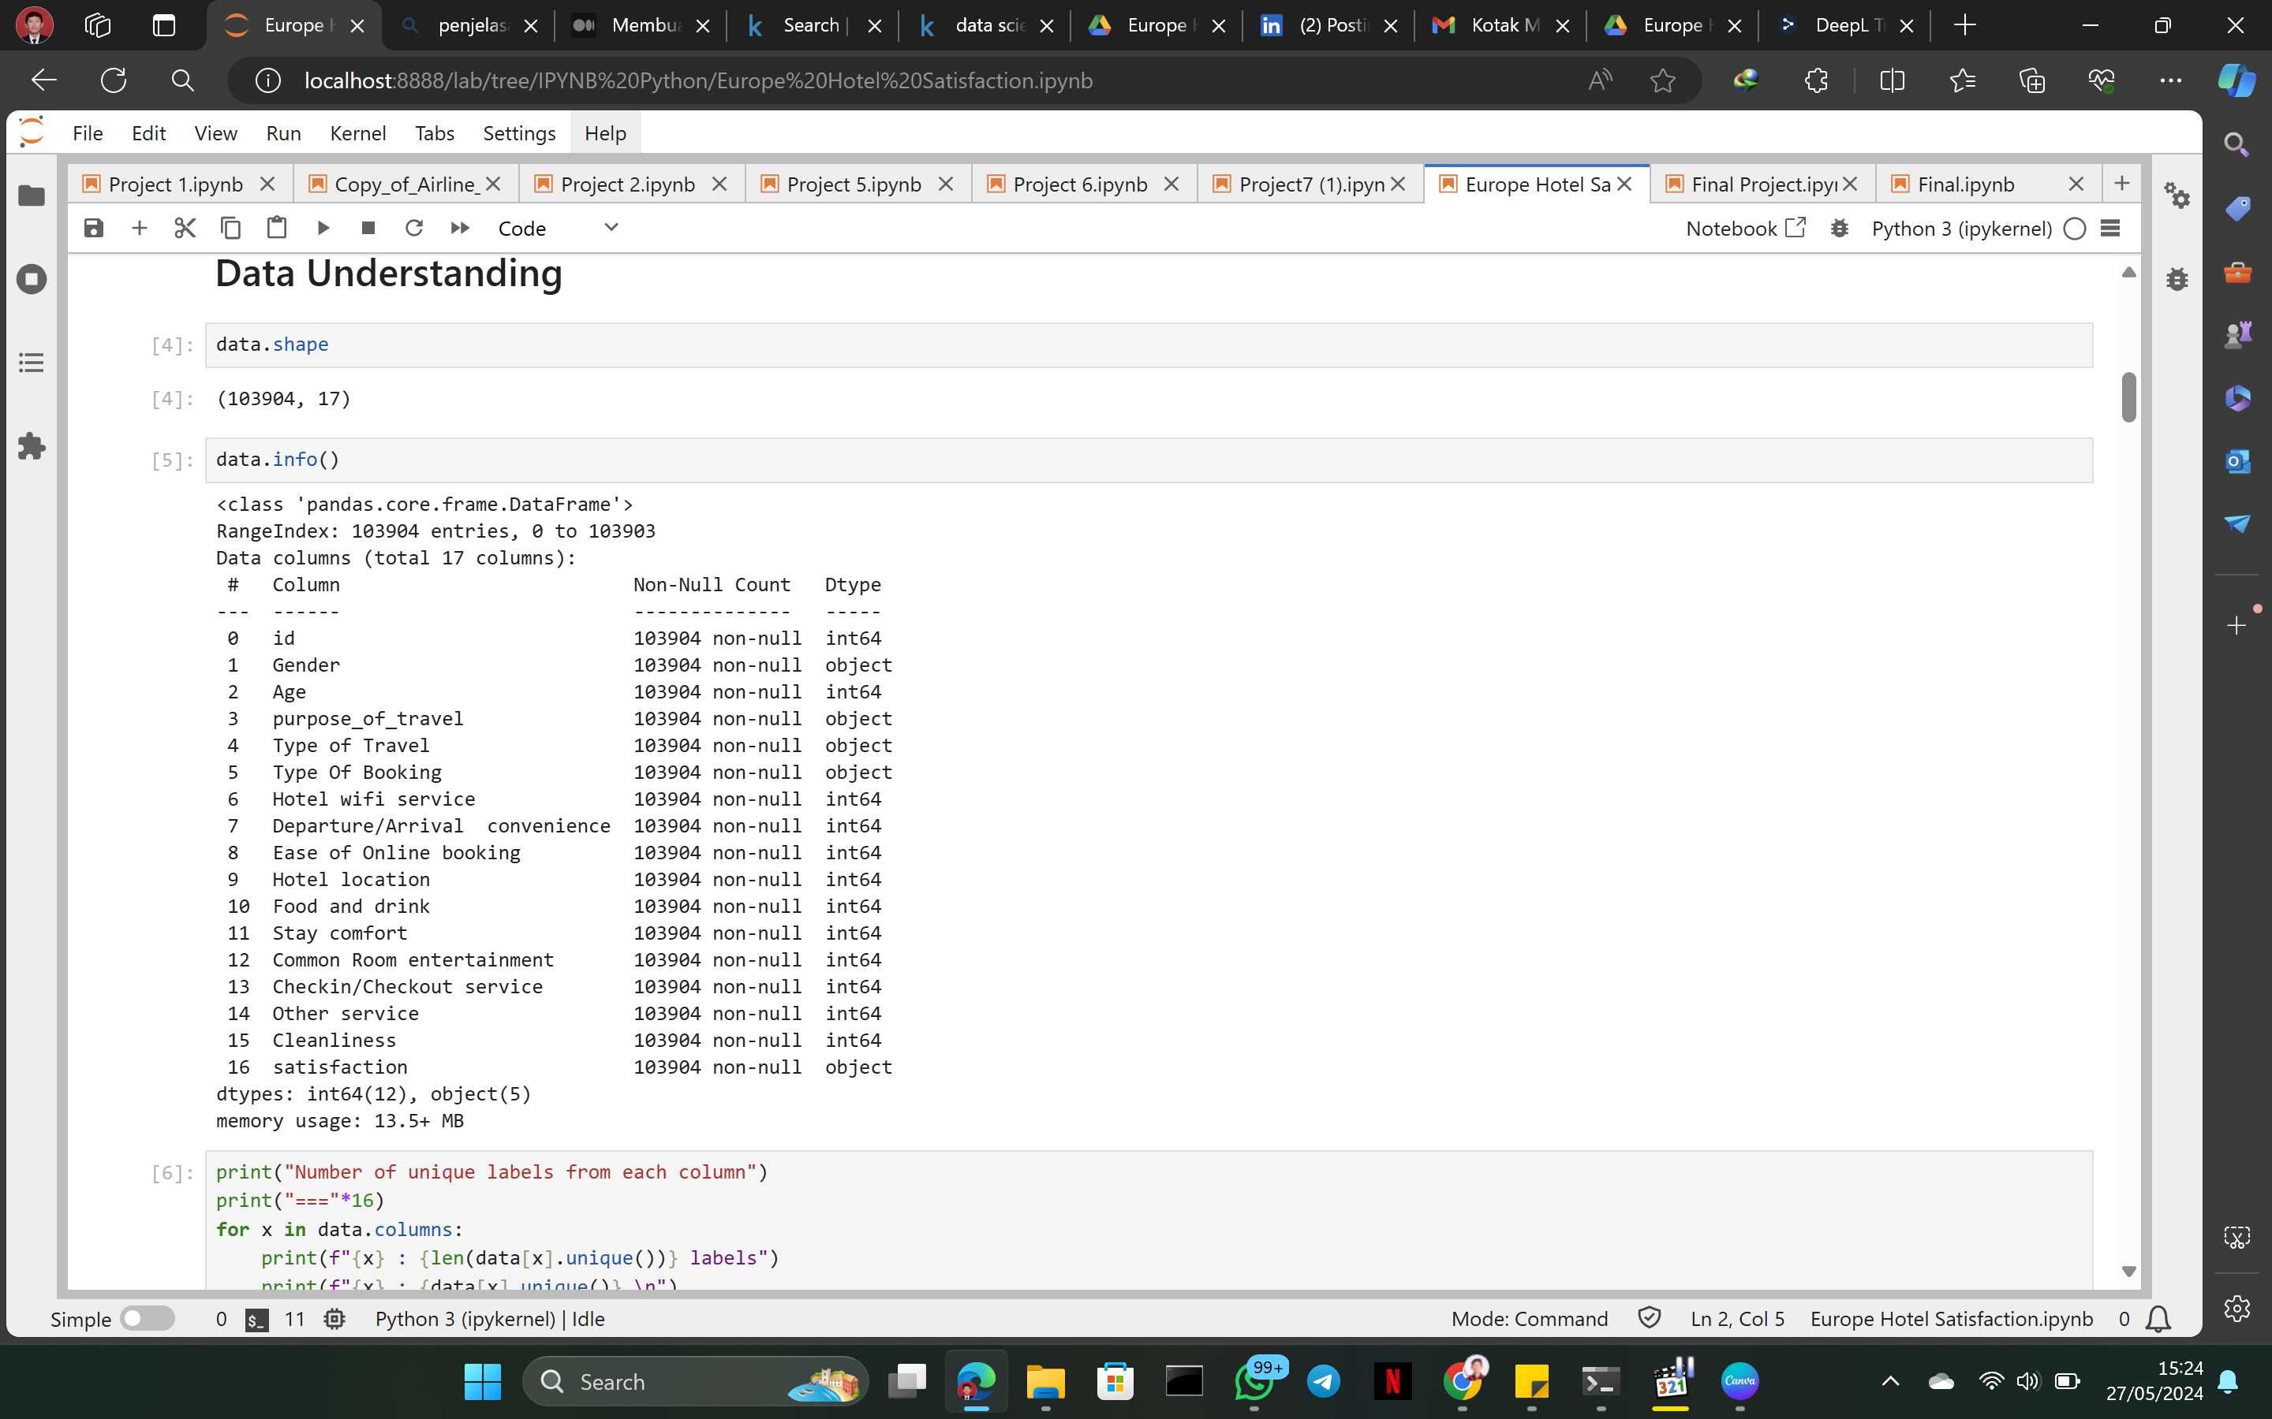



info data
BASED ON THE DISPLAY, WE GET INFORMATION THAT THIS DATA SET HAS 17 COLUMNS AND 103904 ROWS WHERE THE FIRST NUMBER STARTS FROM 0. AFTER THAT WE CAN ALSO SEE THAT THE 17 COLUMNS ARE DIVIDED INTO 2 DATA TYPES, NAMELY OBJECT DATA AS MUCH AS 5 AND INT (NUMBER) DATA AS MUCH AS 12 DATA.

Slide 8
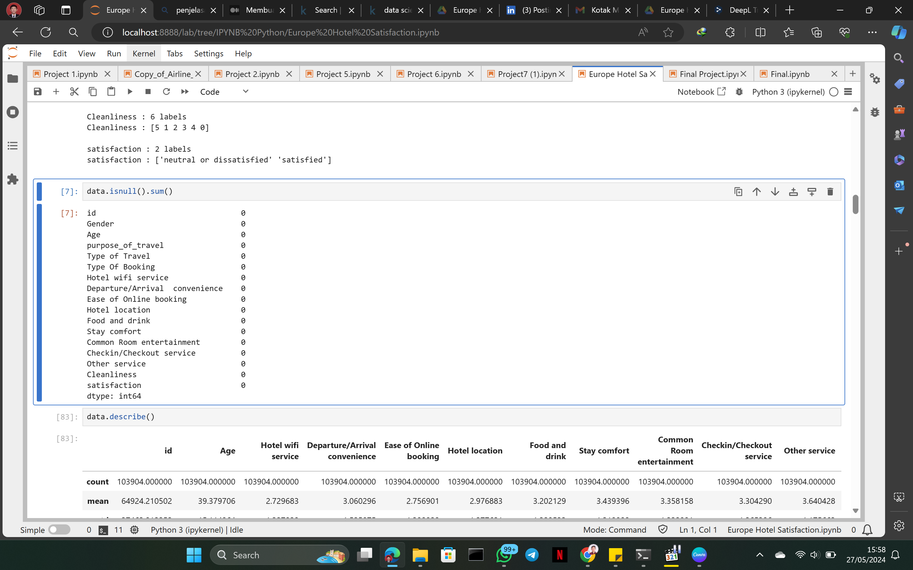
check for missing values
AFTER GETTING INFORMATION ABOUT THE DATA, WE CHECK WHETHER THERE IS EMPTY DATA, AND AFTER CHECKING IT TURNS OUT THAT THERE IS NO EMPTY DATA.

Slide 9
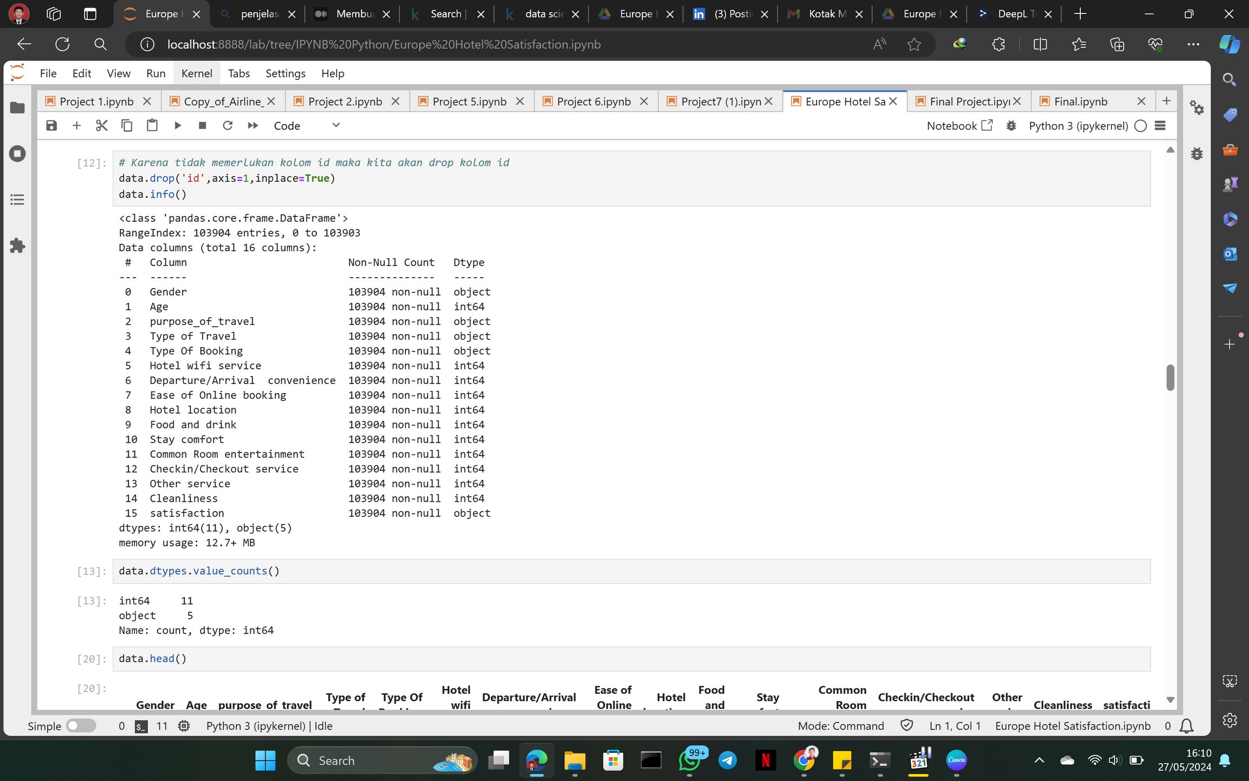
drop coloumn id
BECAUSE THE ID COLUMN IS NOT NEEDED TO ANALYZE THE DATA, WE WILL REMOVE THE ID COLUMN. AFTER THAT WE DISPLAY THE DATA INFO, WE CAN SEE THAT THE ID COLUMN HAS DISAPPEARED AND THERE ARE 16 COLUMNS LEFT.

Slide 10
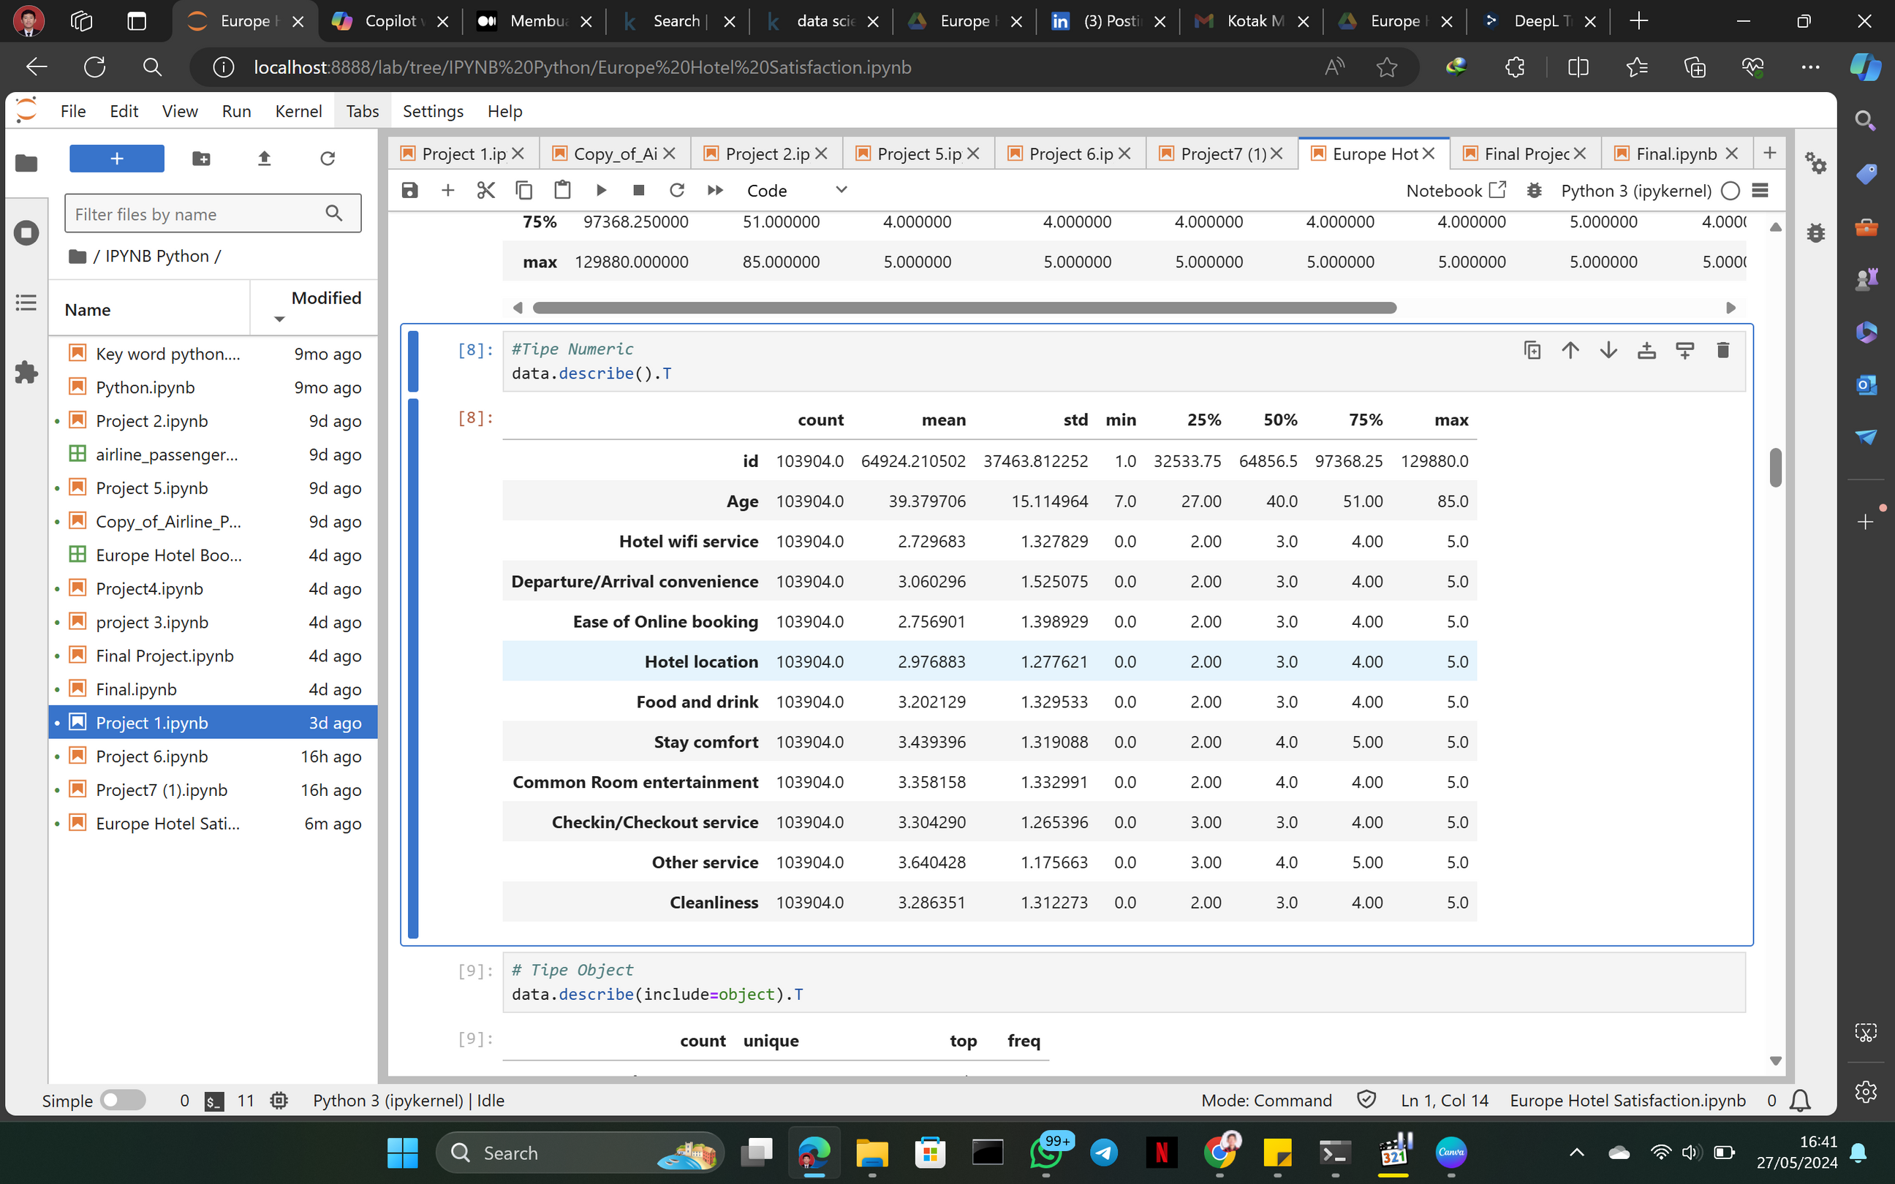
describe data
THE DESCRIBE() FUNCTION IN PANDAS IS USED TO DISPLAY DESCRIPTIVE STATISTICS OF A DATA FRAME OR SERIES. THE OUTPUT OF THIS FUNCTION CONTAINS A SUMMARY OF THE CENTRAL TENDENCY AND DISTRIBUTION OF THE DATASET. BY USING DESCRIBE(), WE CAN GET AN OVERVIEW OF THE DATA BEING ANALYZED

Slide 11
CODE AND VISUALIZATION

Slide 12
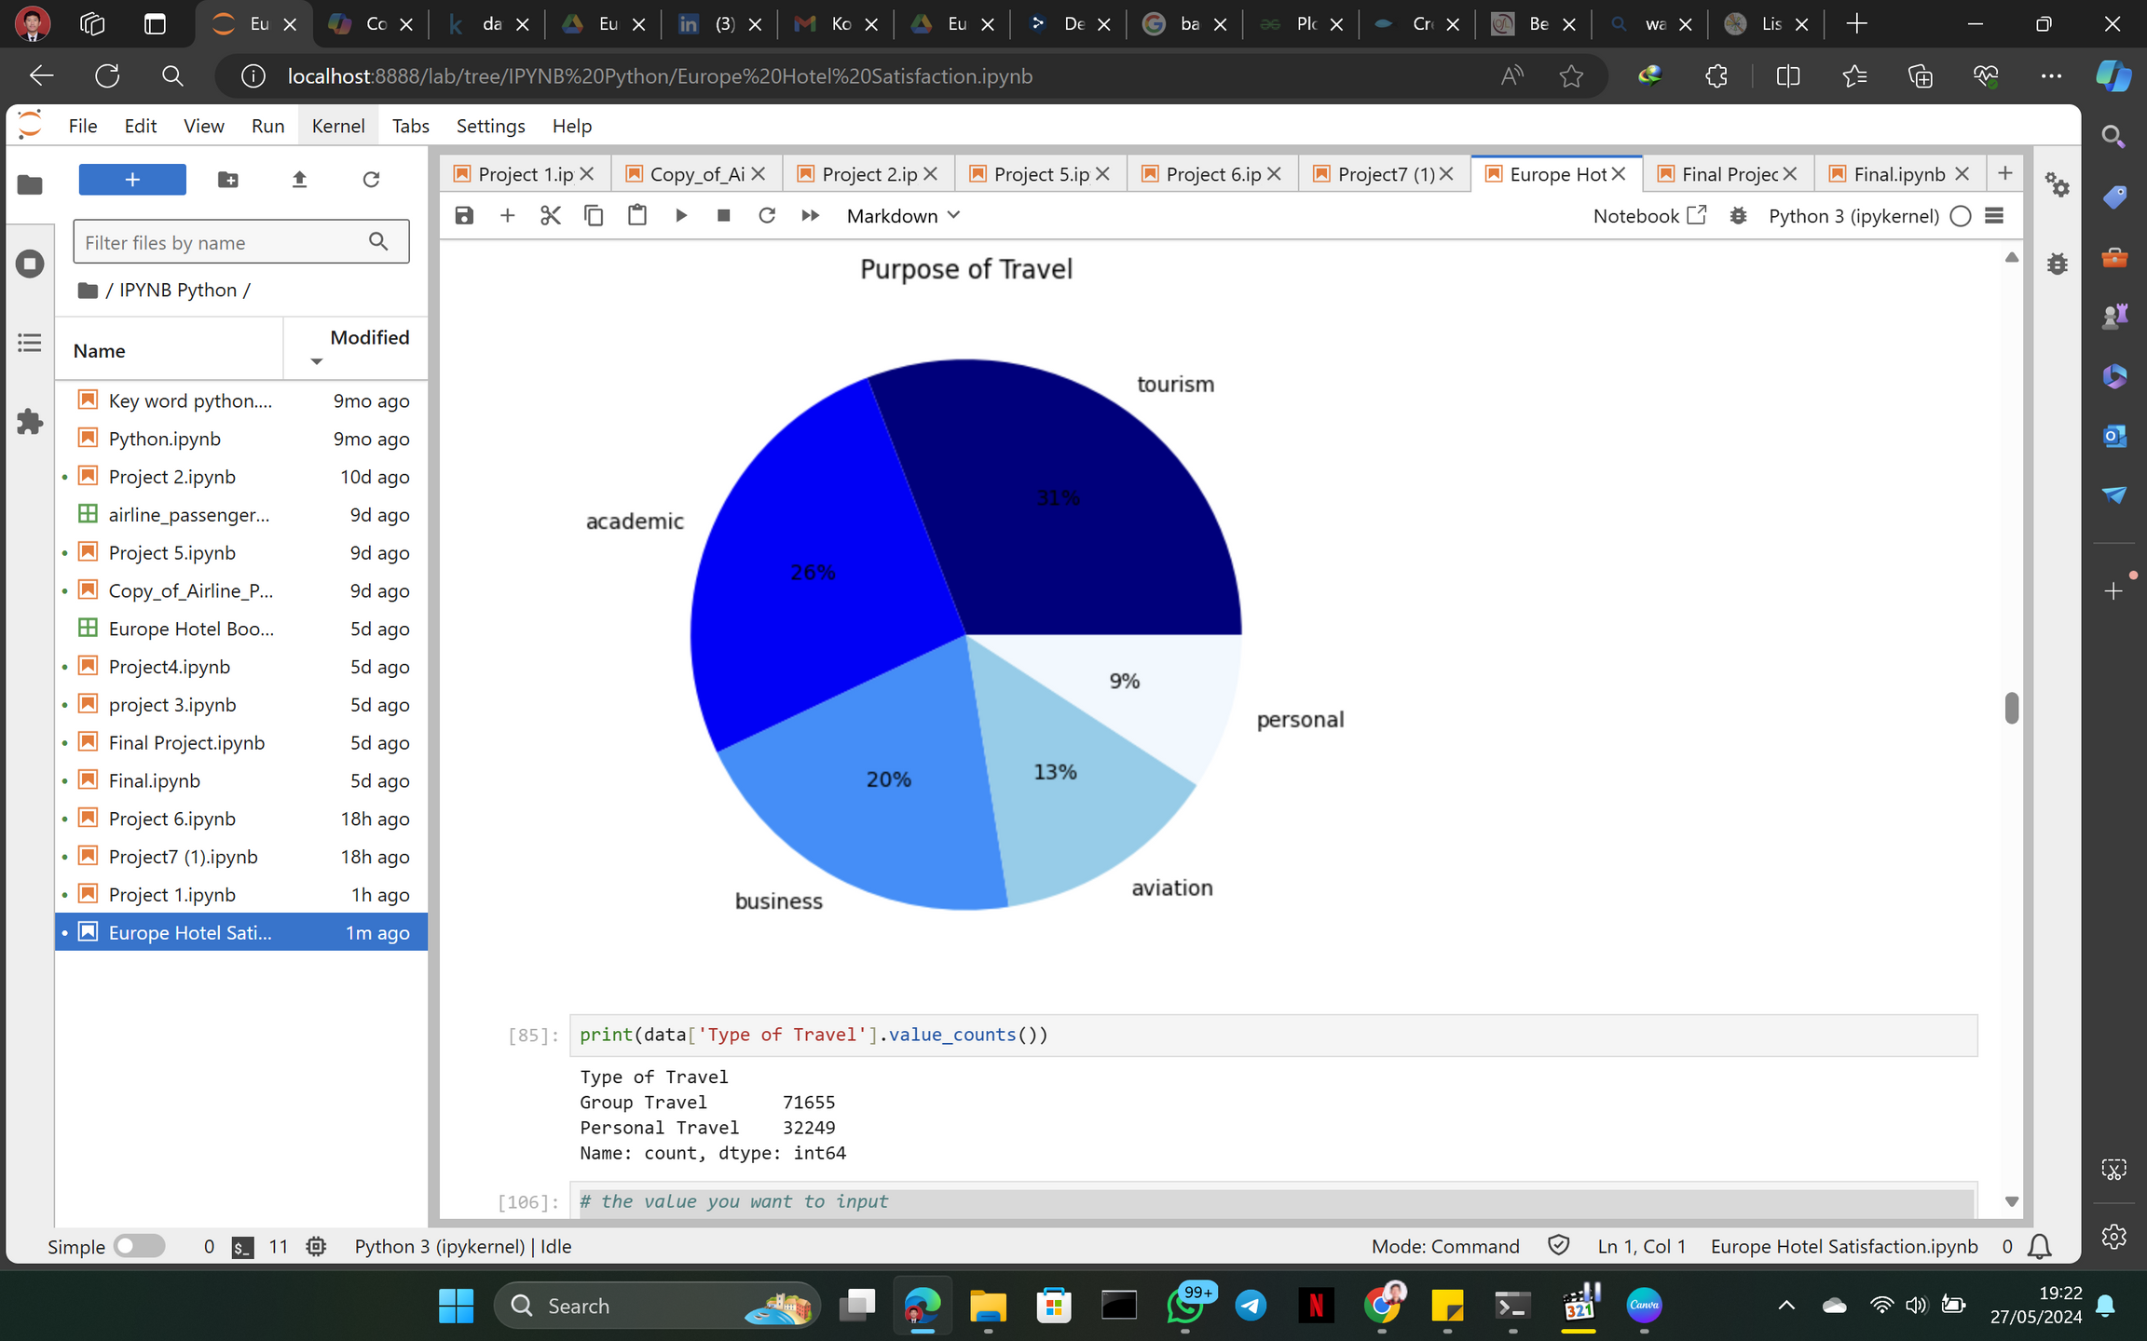
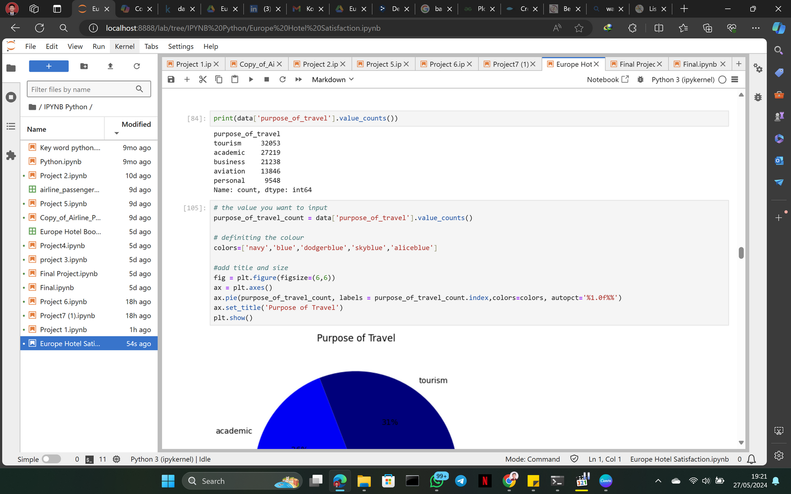



what is the percentage of visitors purpose of travel
From the visible display we can find out the most purpose of travel are on tourism.
The diagram shows that purpose of travel for tourism is 31%, academic 26%, business 20%, aviation 13%, personal 9%

Slide 13

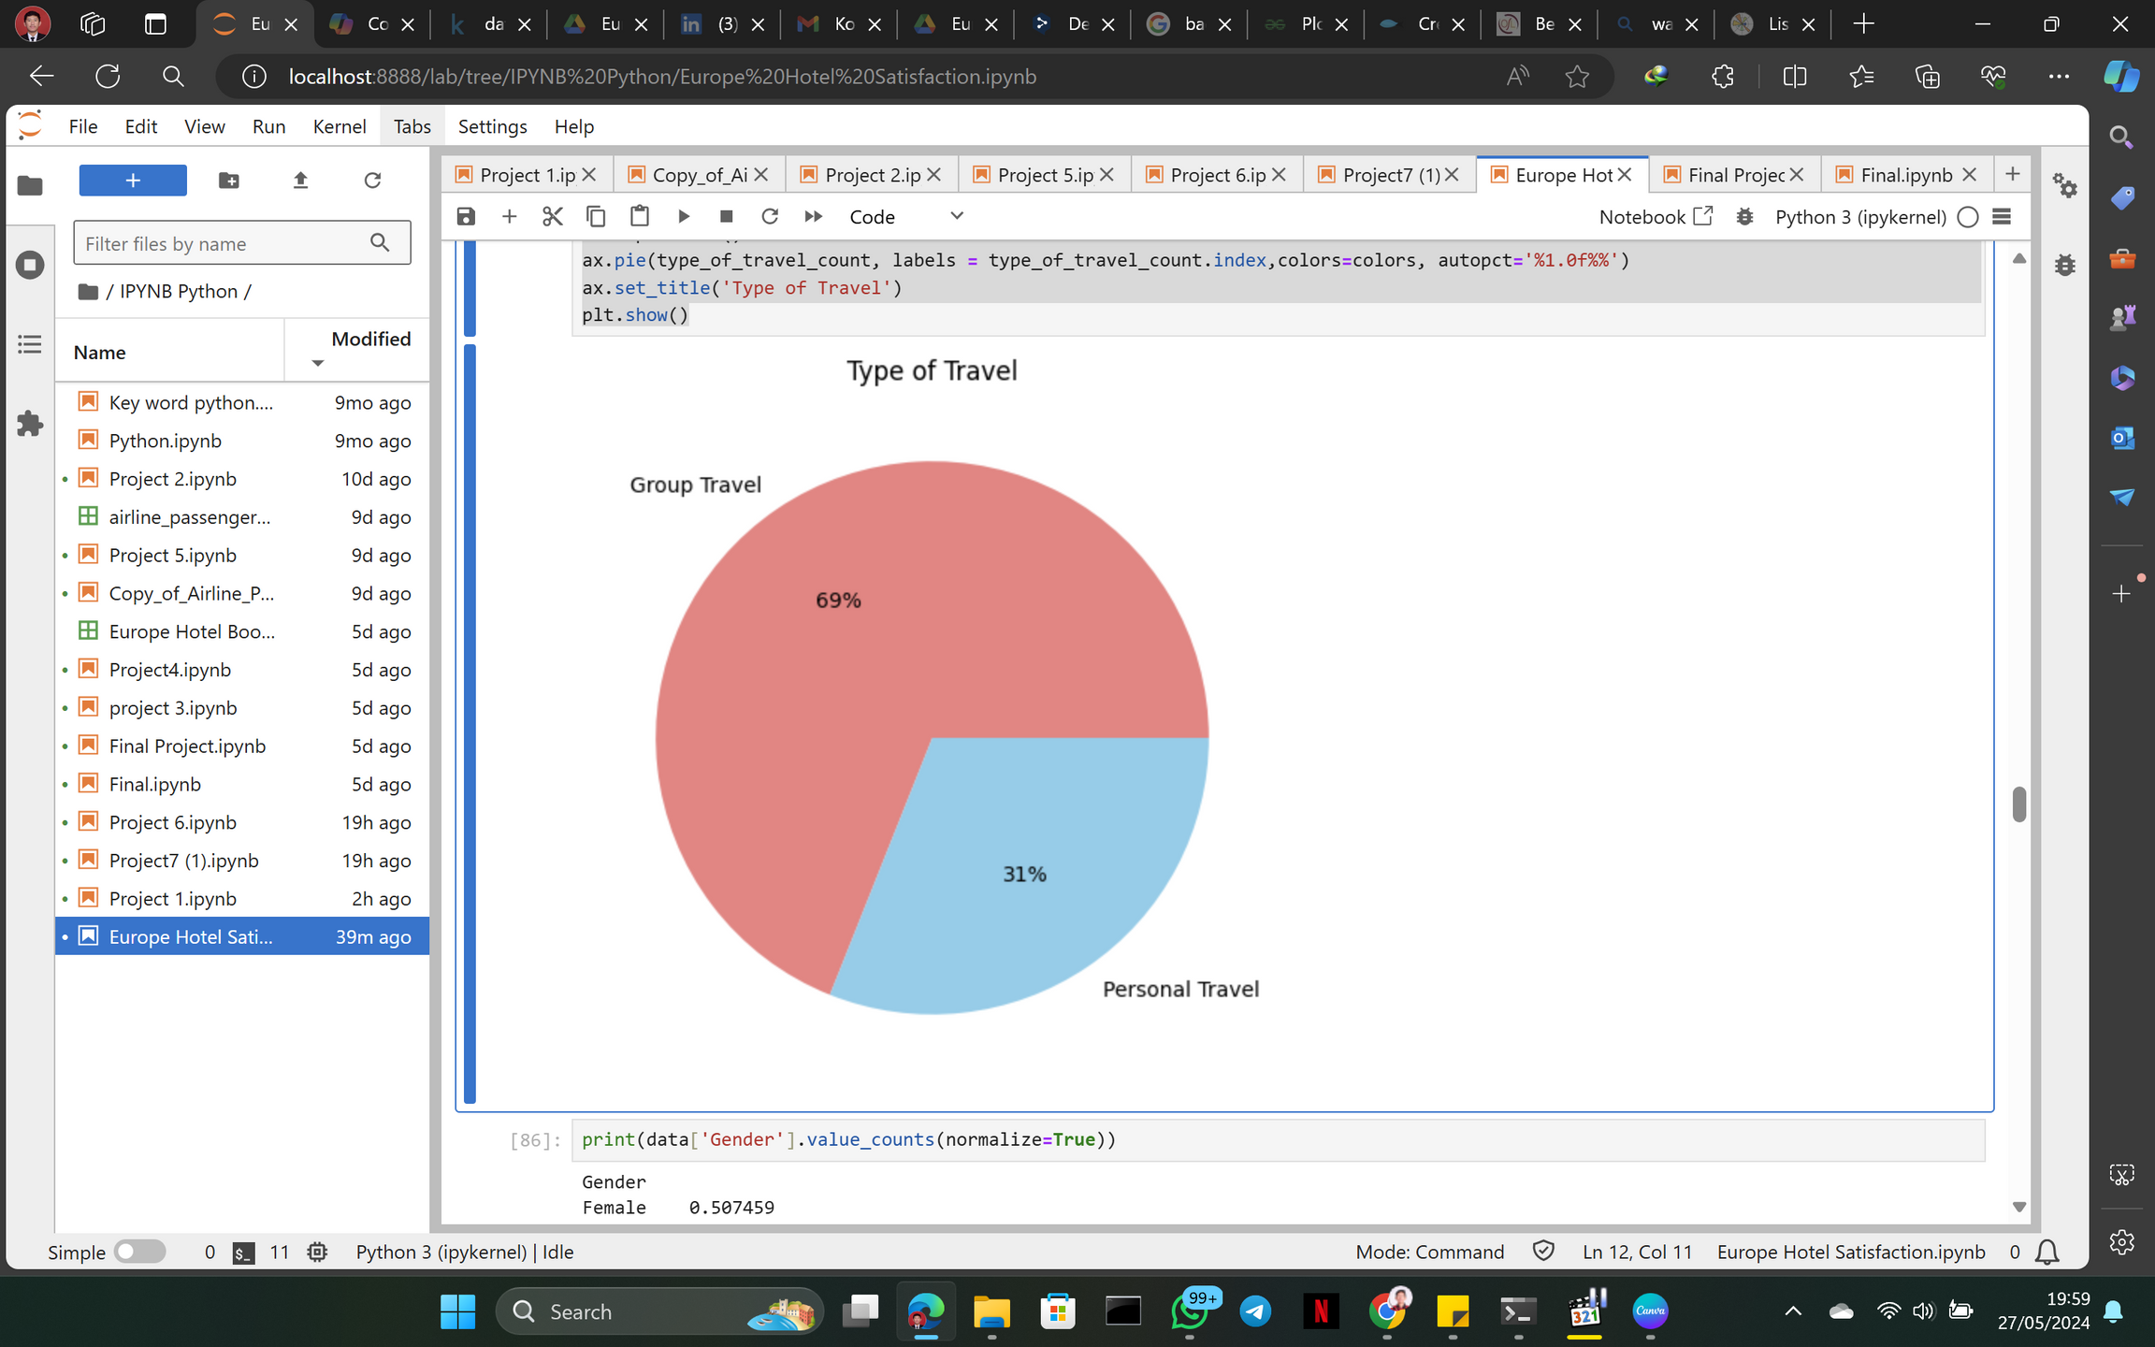
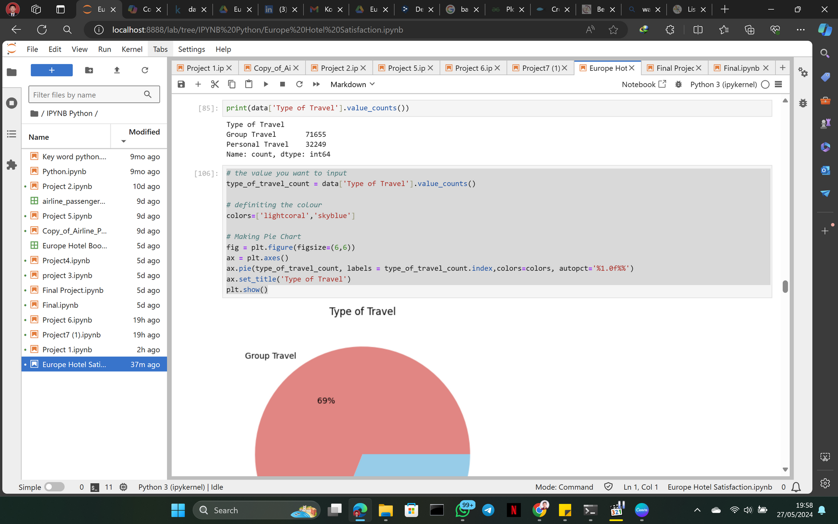

what is the percentage of visitors type of travel
From the visible display we can find out the most type of travel are on group travel.
The diagram shows that type of travel for Group Travel is 69% and Personal Travel 31% the comparison is quite far.so this shows that hotel visitors prefer to travel together rather than alone.

Slide 14
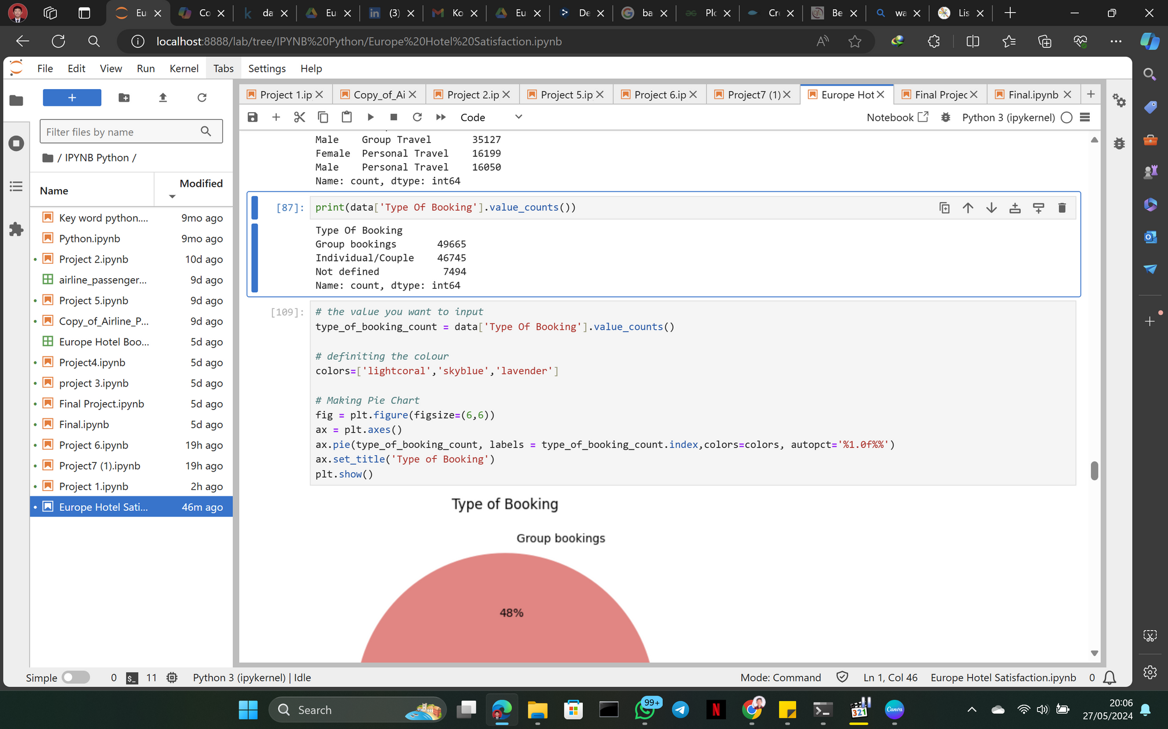
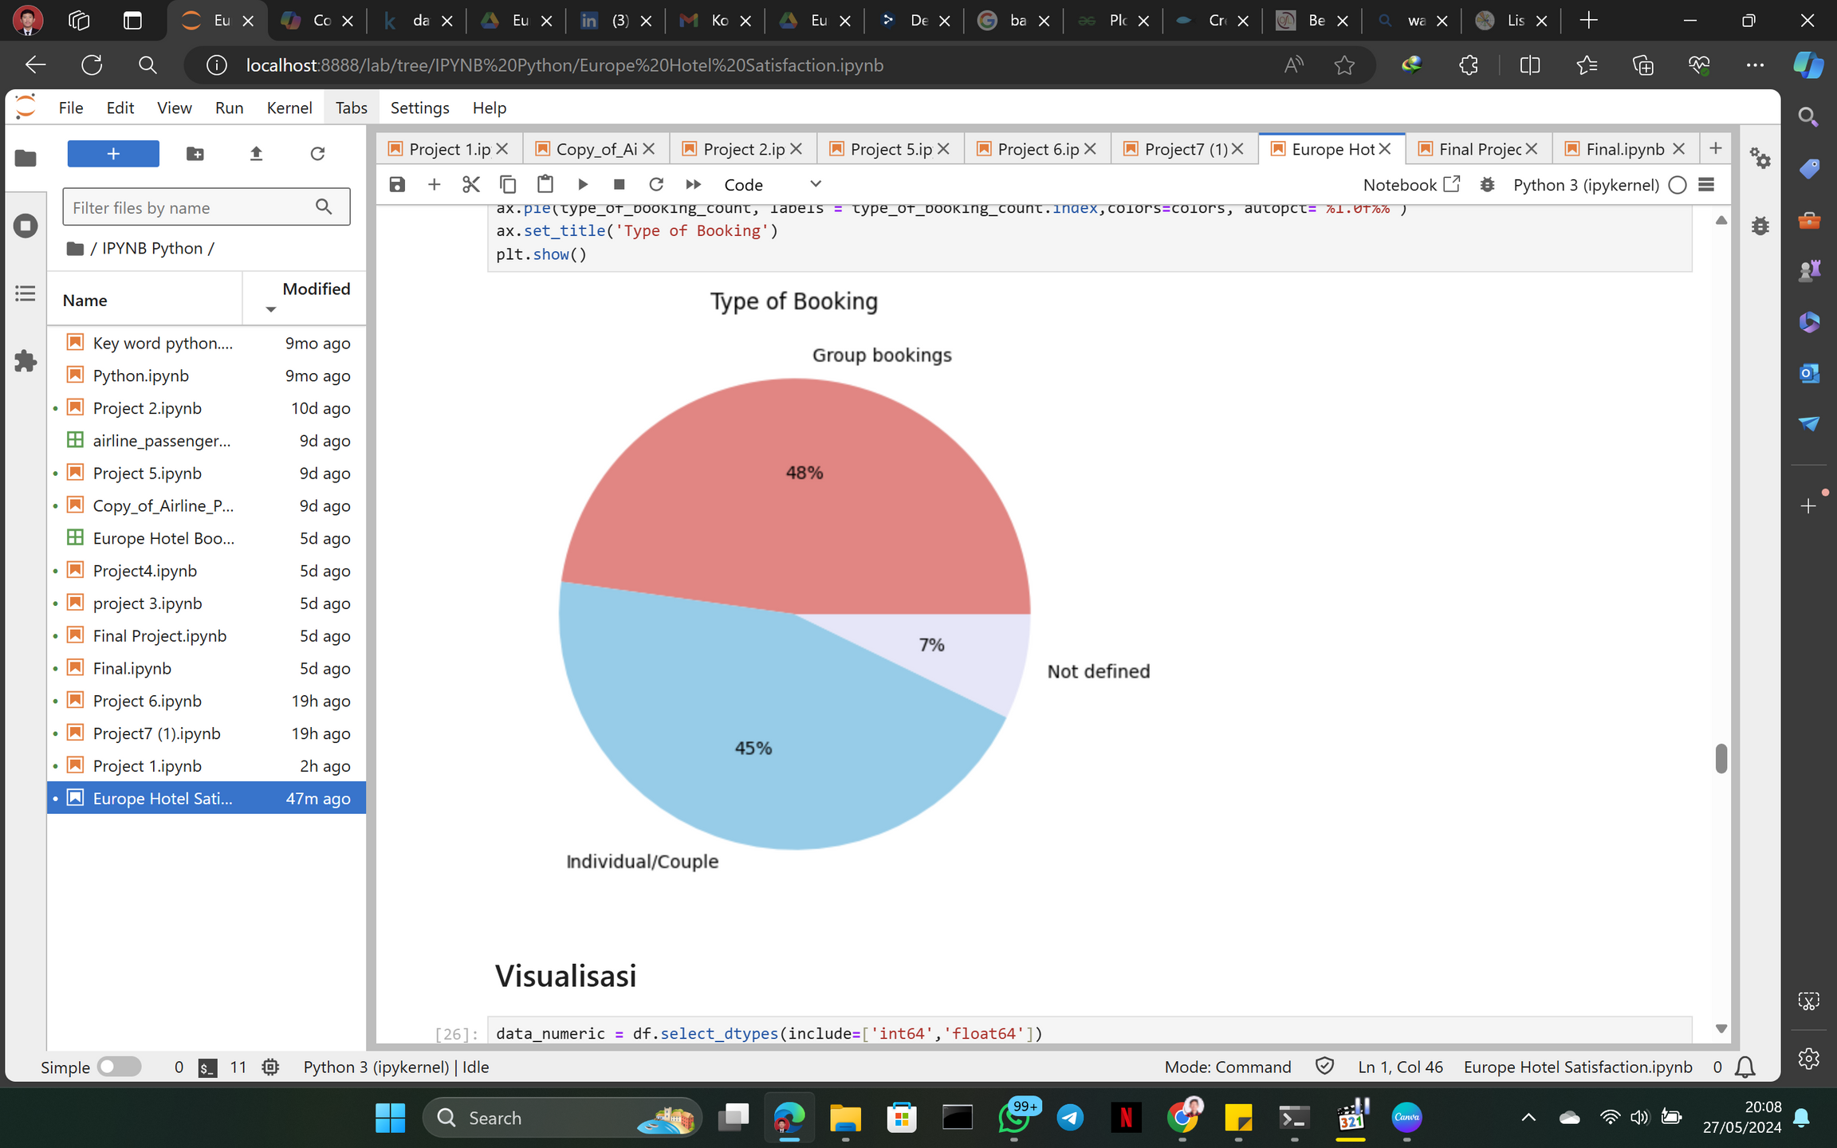
what is the percentage of visitors type of booking
From the visible display we can find out the most type of Booking are on group booking.
The diagram shows that type of Booking for Group Booking is 48% , Individual/Couple 45%, and Not Defined 7%.

Slide 15
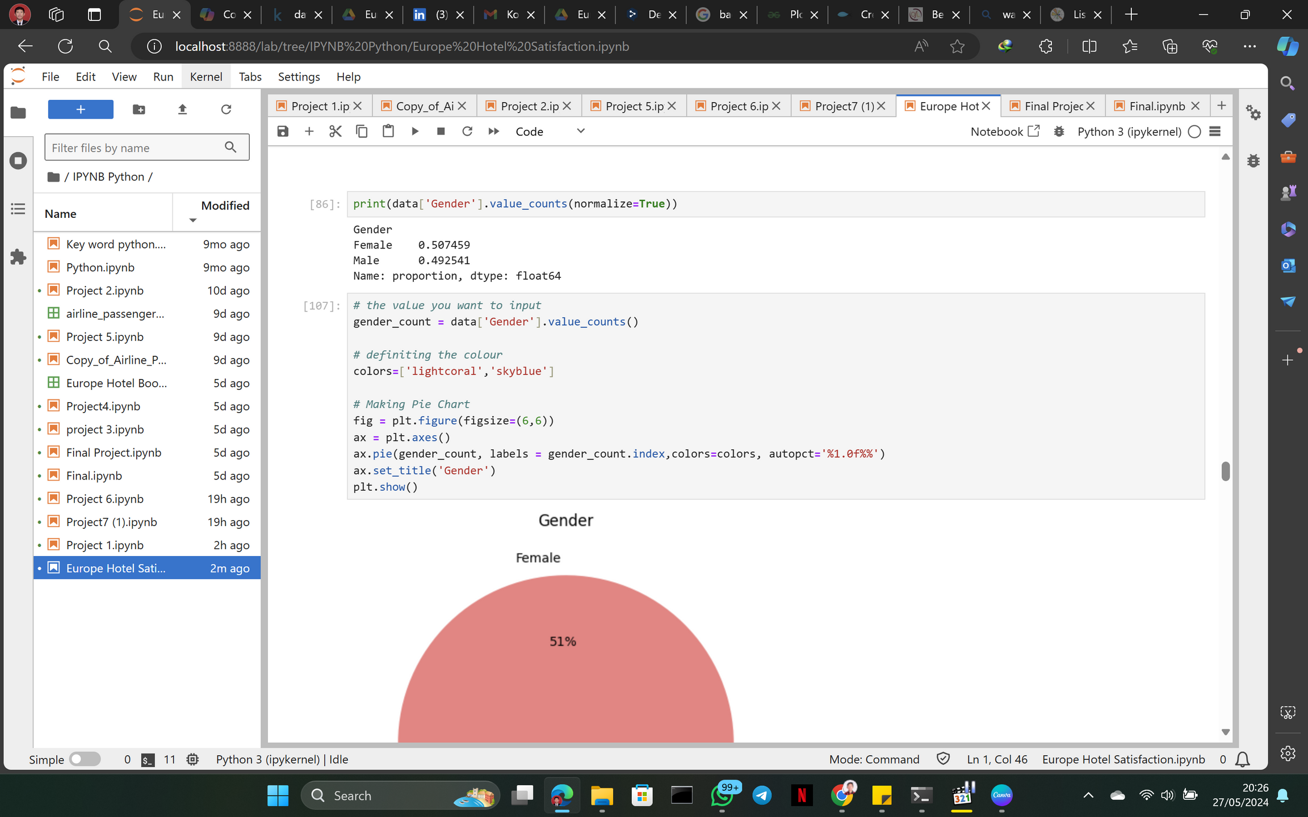
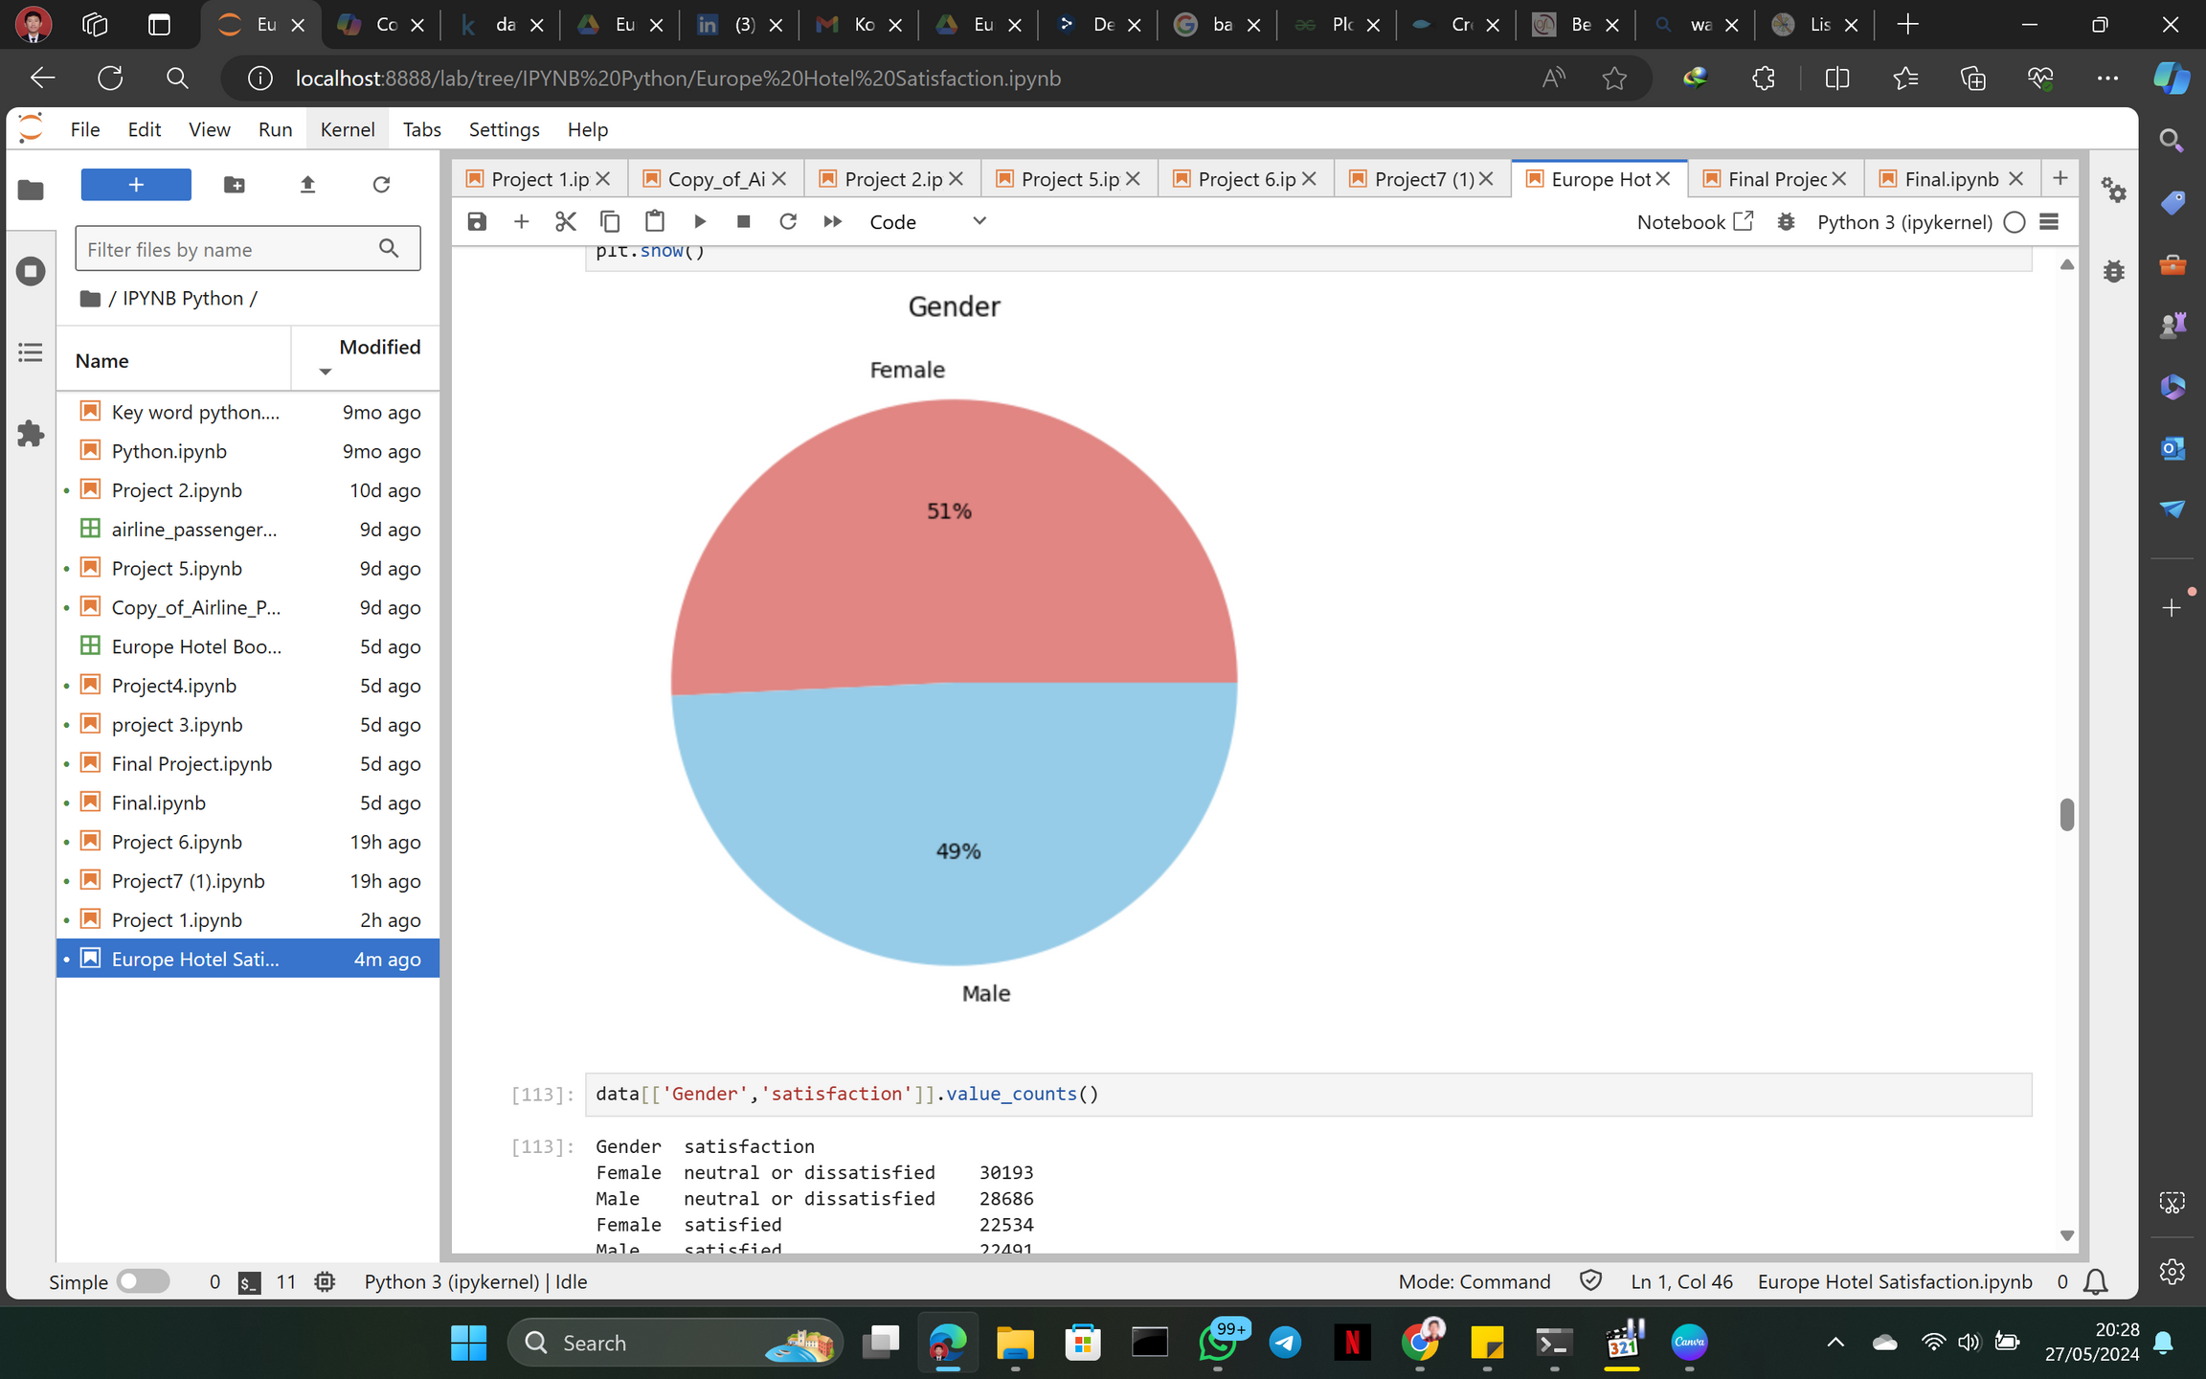


what is the percentage of visitors by gender
From the visible display we can find out the most type of Booking are on group booking.
The diagram shows that most visitors by gender are Female as much as 51% , and Male 49%, the ratio is very thin.

Slide 16
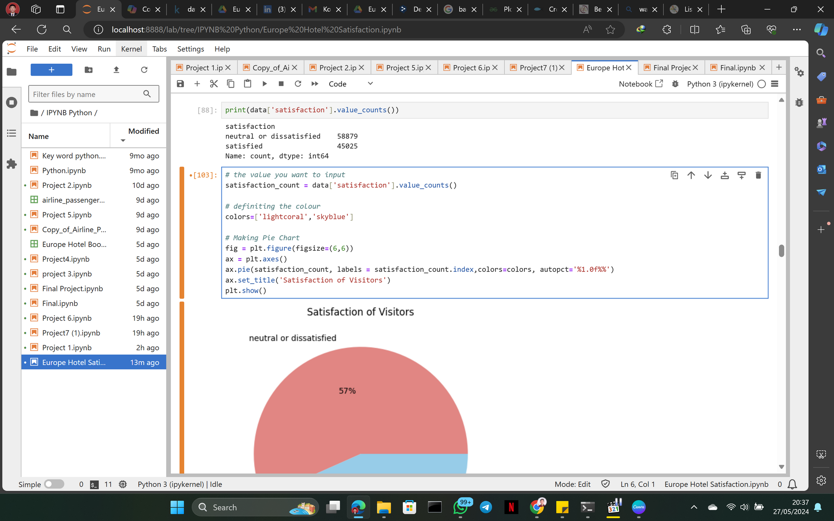
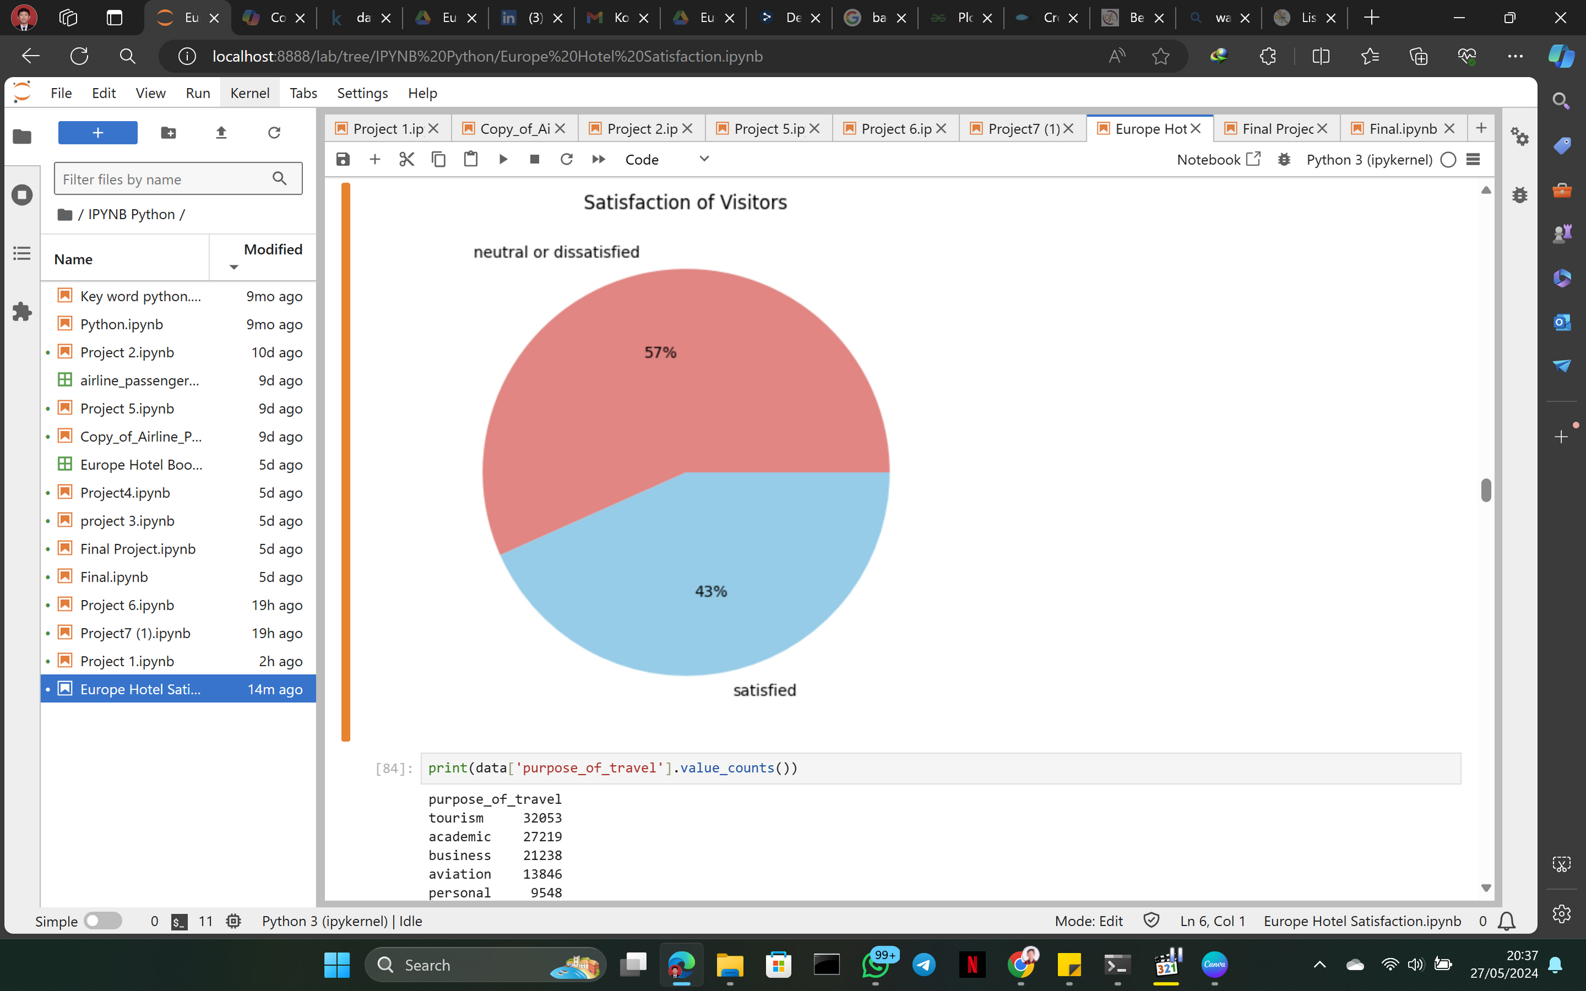
how is the percentage of visitor satisfaction
visitor satisfaction is a very important part of the hotel.
here we can see as many as 57% of visitors feel neutral or dissatisfied and the remaining 43% of visitors who feel satisfied this can result in a bad rating for the hotel. so from here we will see what makes visitors dissatisfied and maybe it will be material for hotel evaluation.

Slide 17
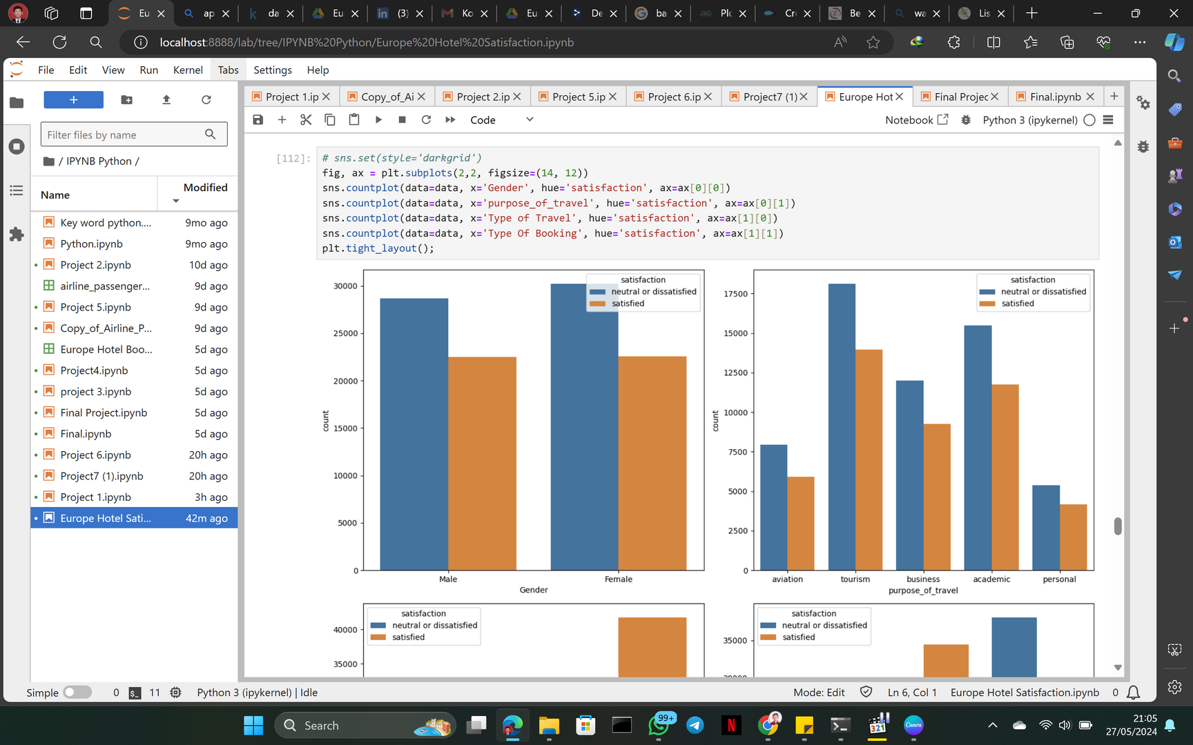
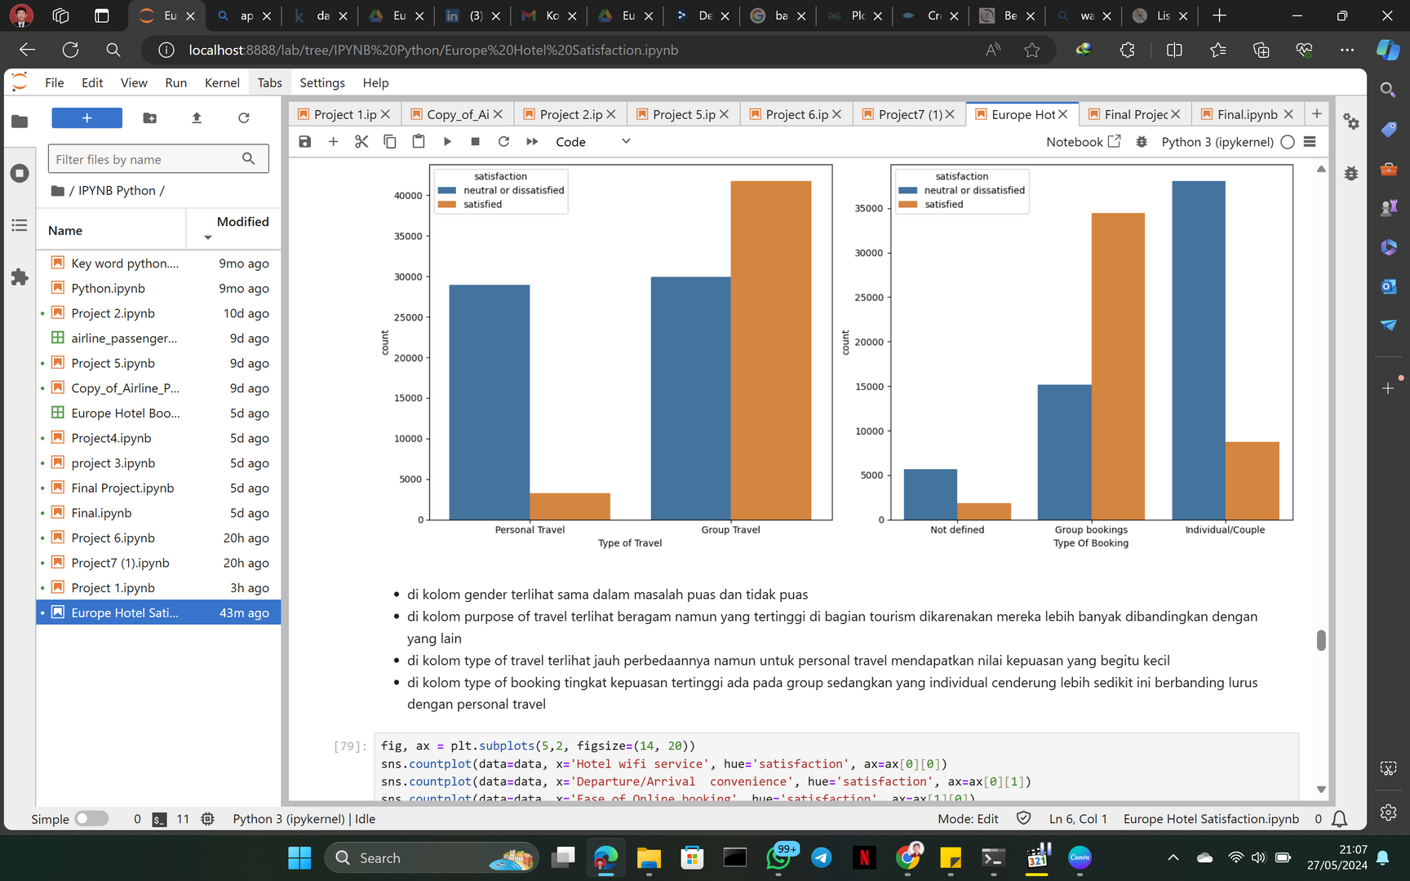
comparison of satisfaction with data objects
Based on the above visualization we can conclude:
In the Gender column, the number of Satisfied and Dissatisfied is almost the same
In the purpose of travel column, the highest number of Satisfied and Dissatisfied is in the type of tourism trip. This can be due to the fact that travel in terms of tourism is the most numerous compared to others.
In the type of travel column, the level of satisfaction is high for group-type trips, which is around 40k while on personal trips it is only around 2500
In the type of booking column, the level of satisfaction is high at the level of group bookings, which is around 34k, it is directly proportional to the type of group travel, while for individual/couple booking types that satisfy only about 9000, it is also directly proportional to the type of personal travel.

Slide 18
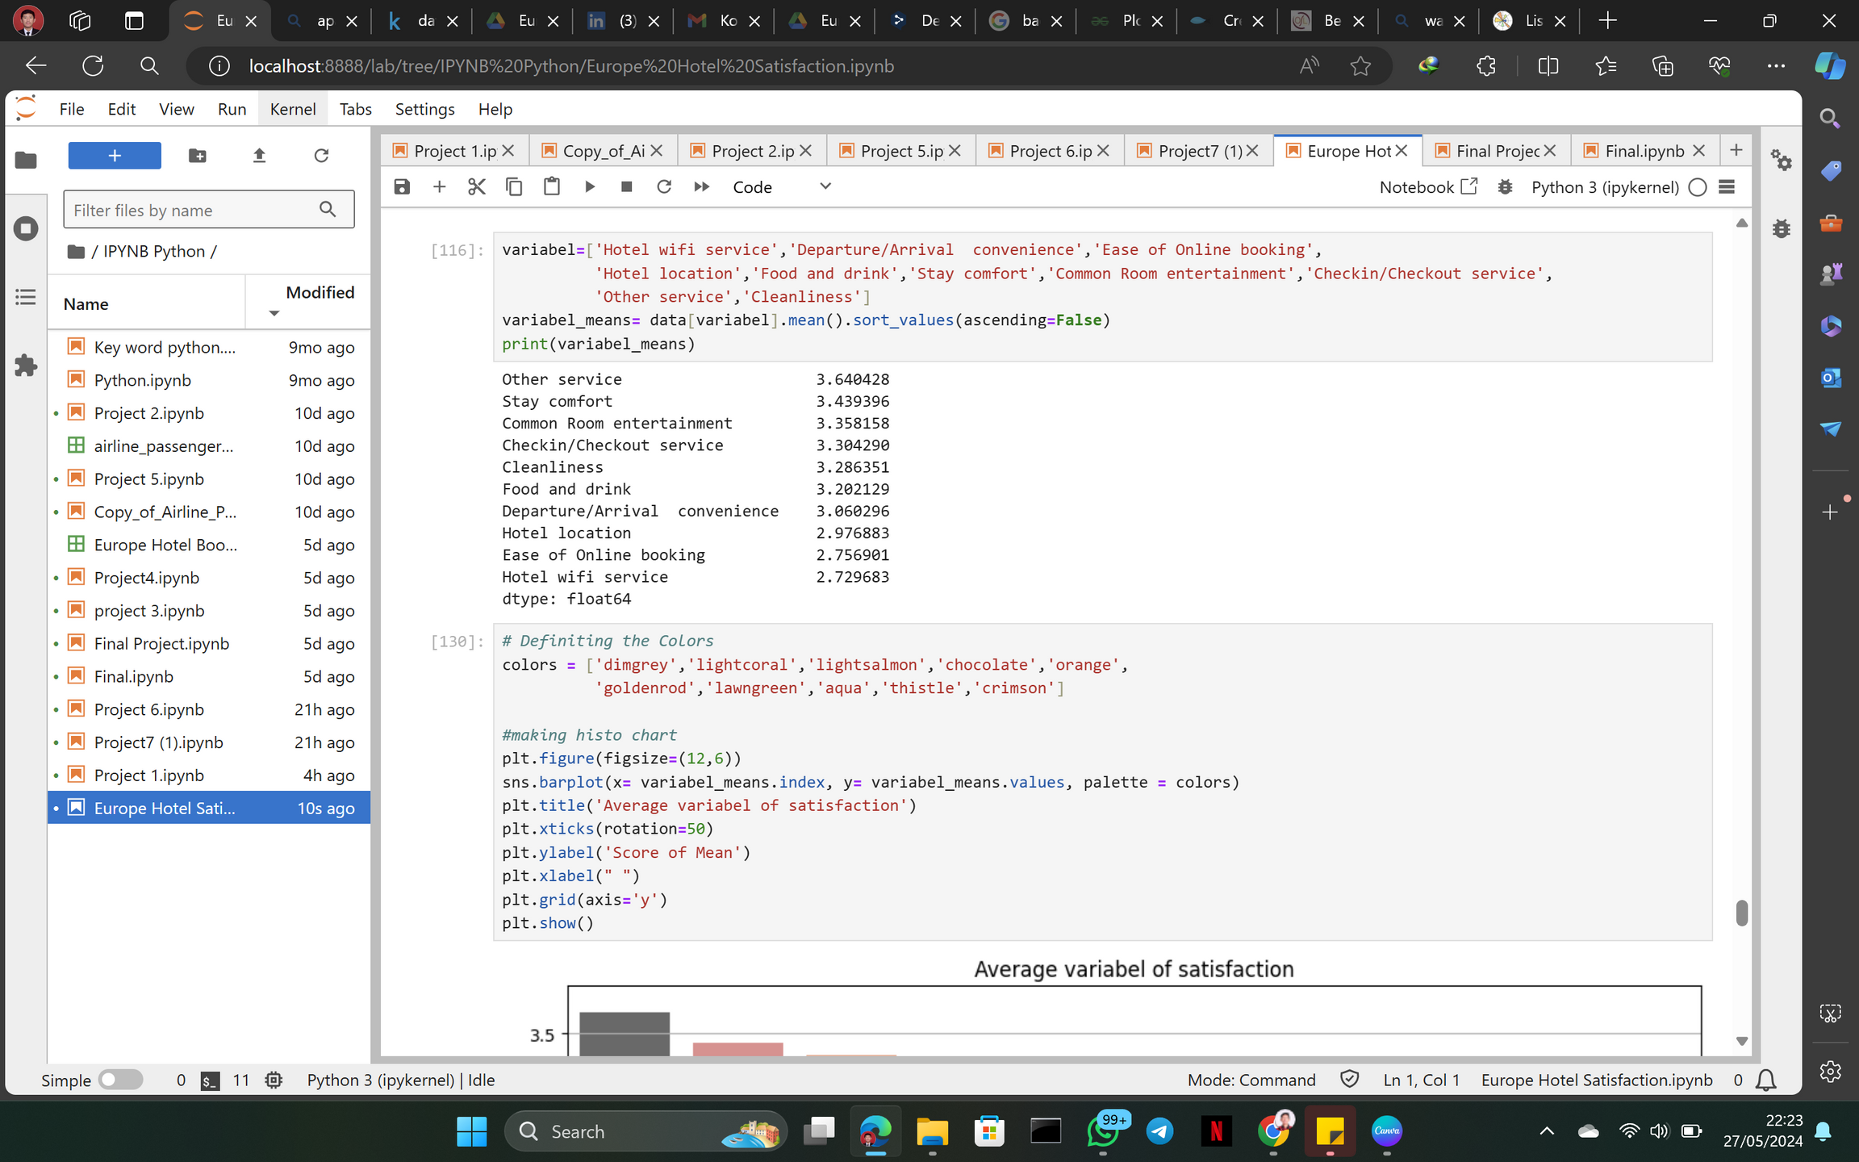
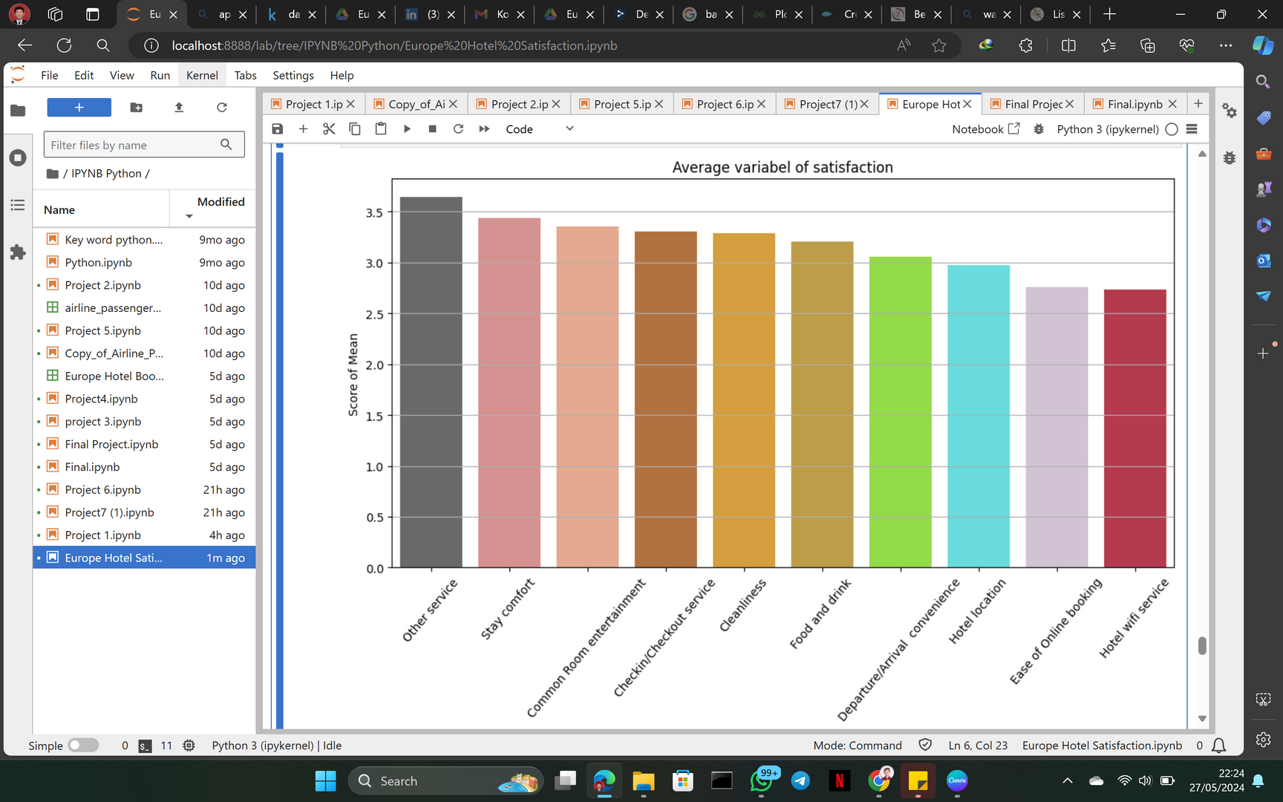


variables that factor into visitor satisfaction and must be improved
After we see the data display, the thing that must be improved is the hotell wifi service, because the average is the lowest compared to the existing facility services.

Slide 19
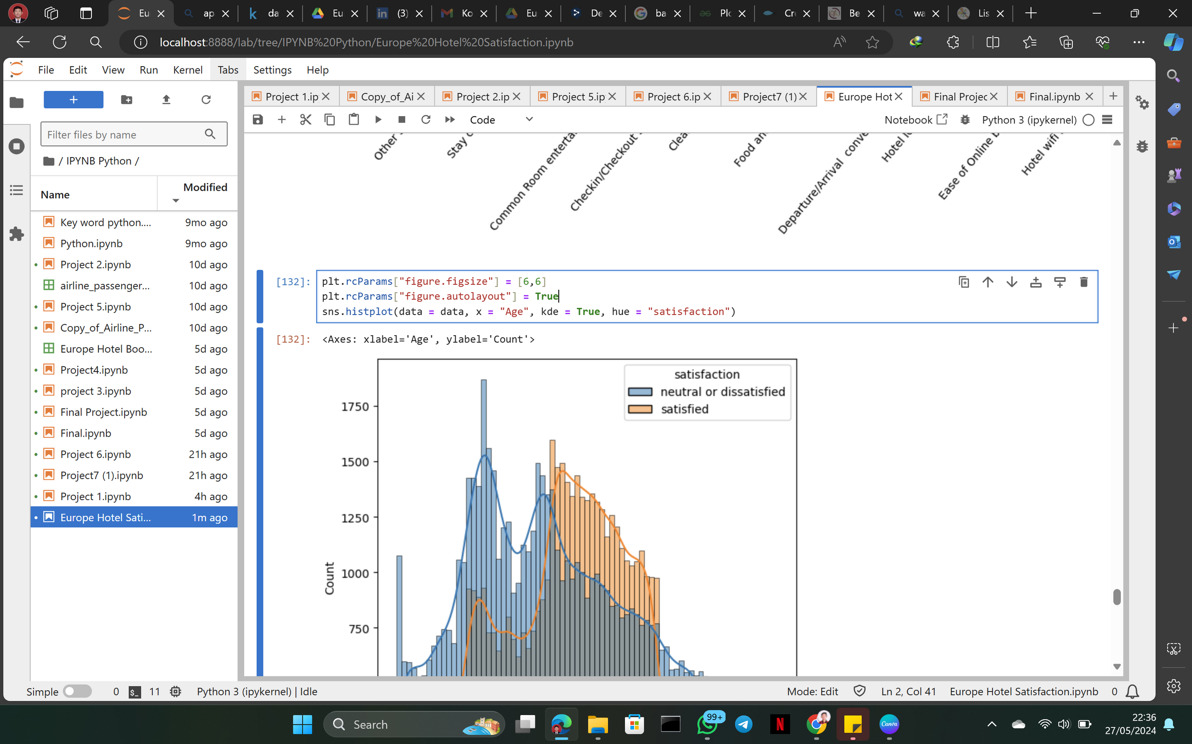

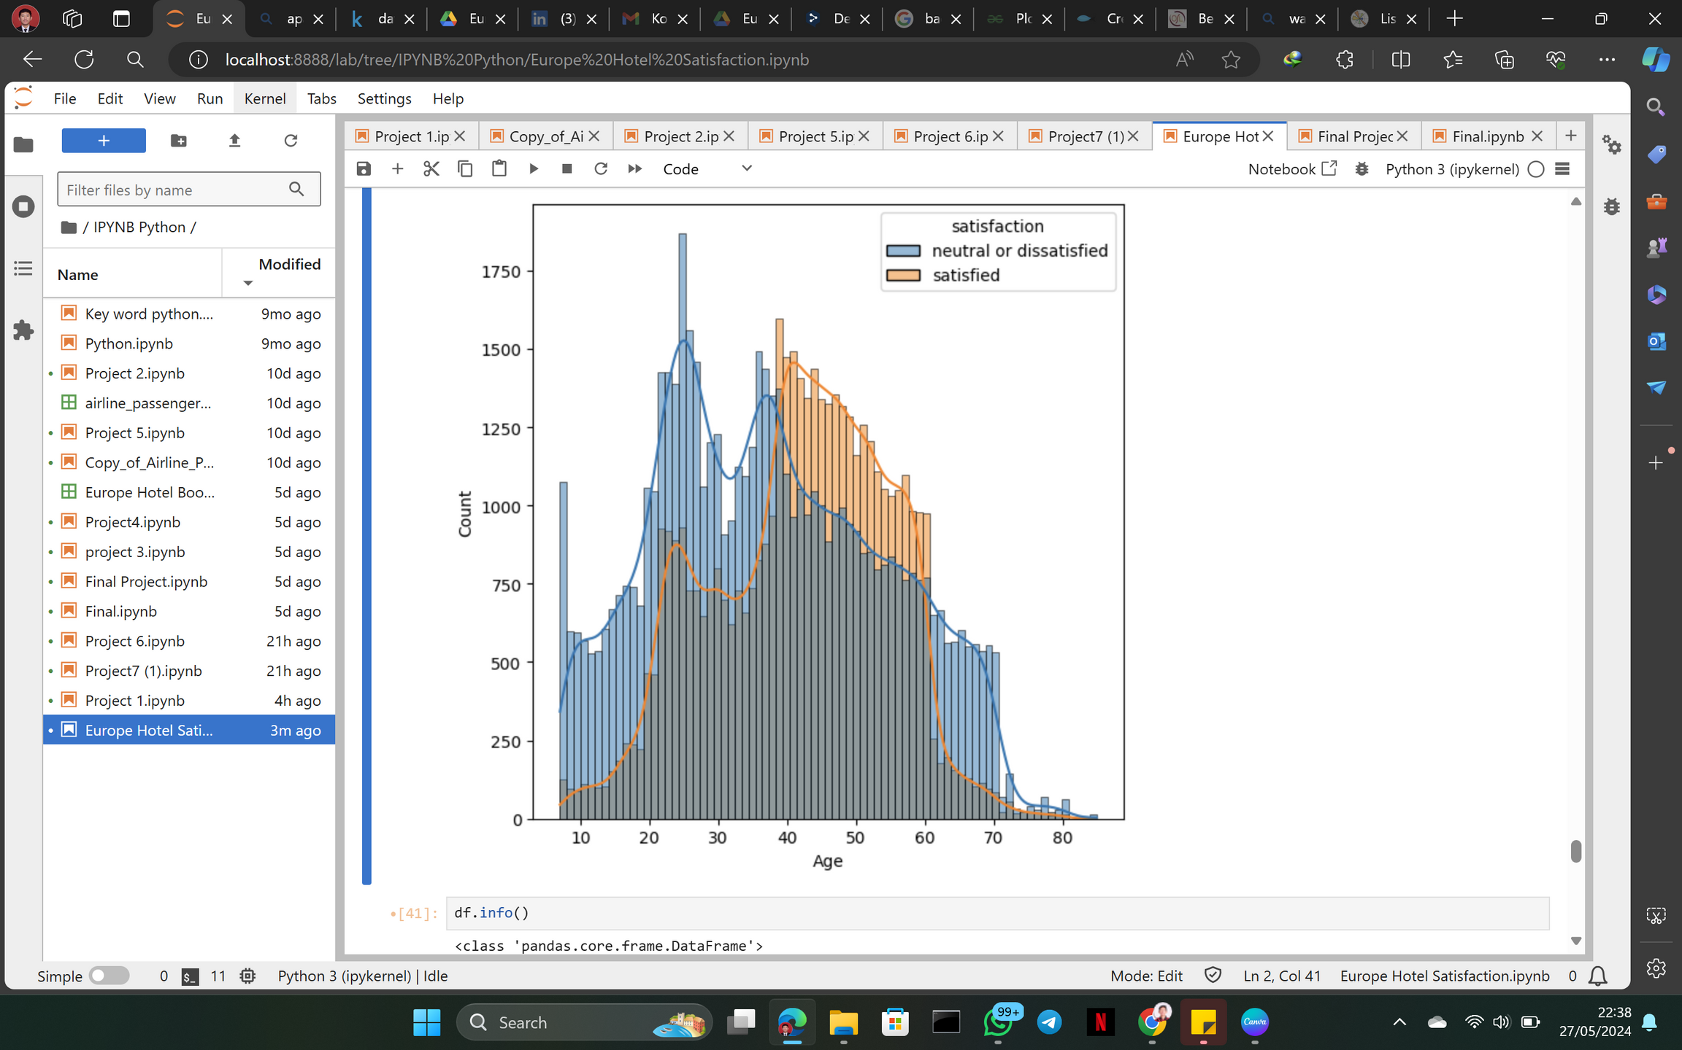
what is the level of satisfaction if based on age
It can be seen that the highest level of satisfaction is in the range of 40-60 while under the age of 40 the average level of satisfaction is dissatisfied and also over the age of 60 feel dissatisfiedf Anda

Slide 20
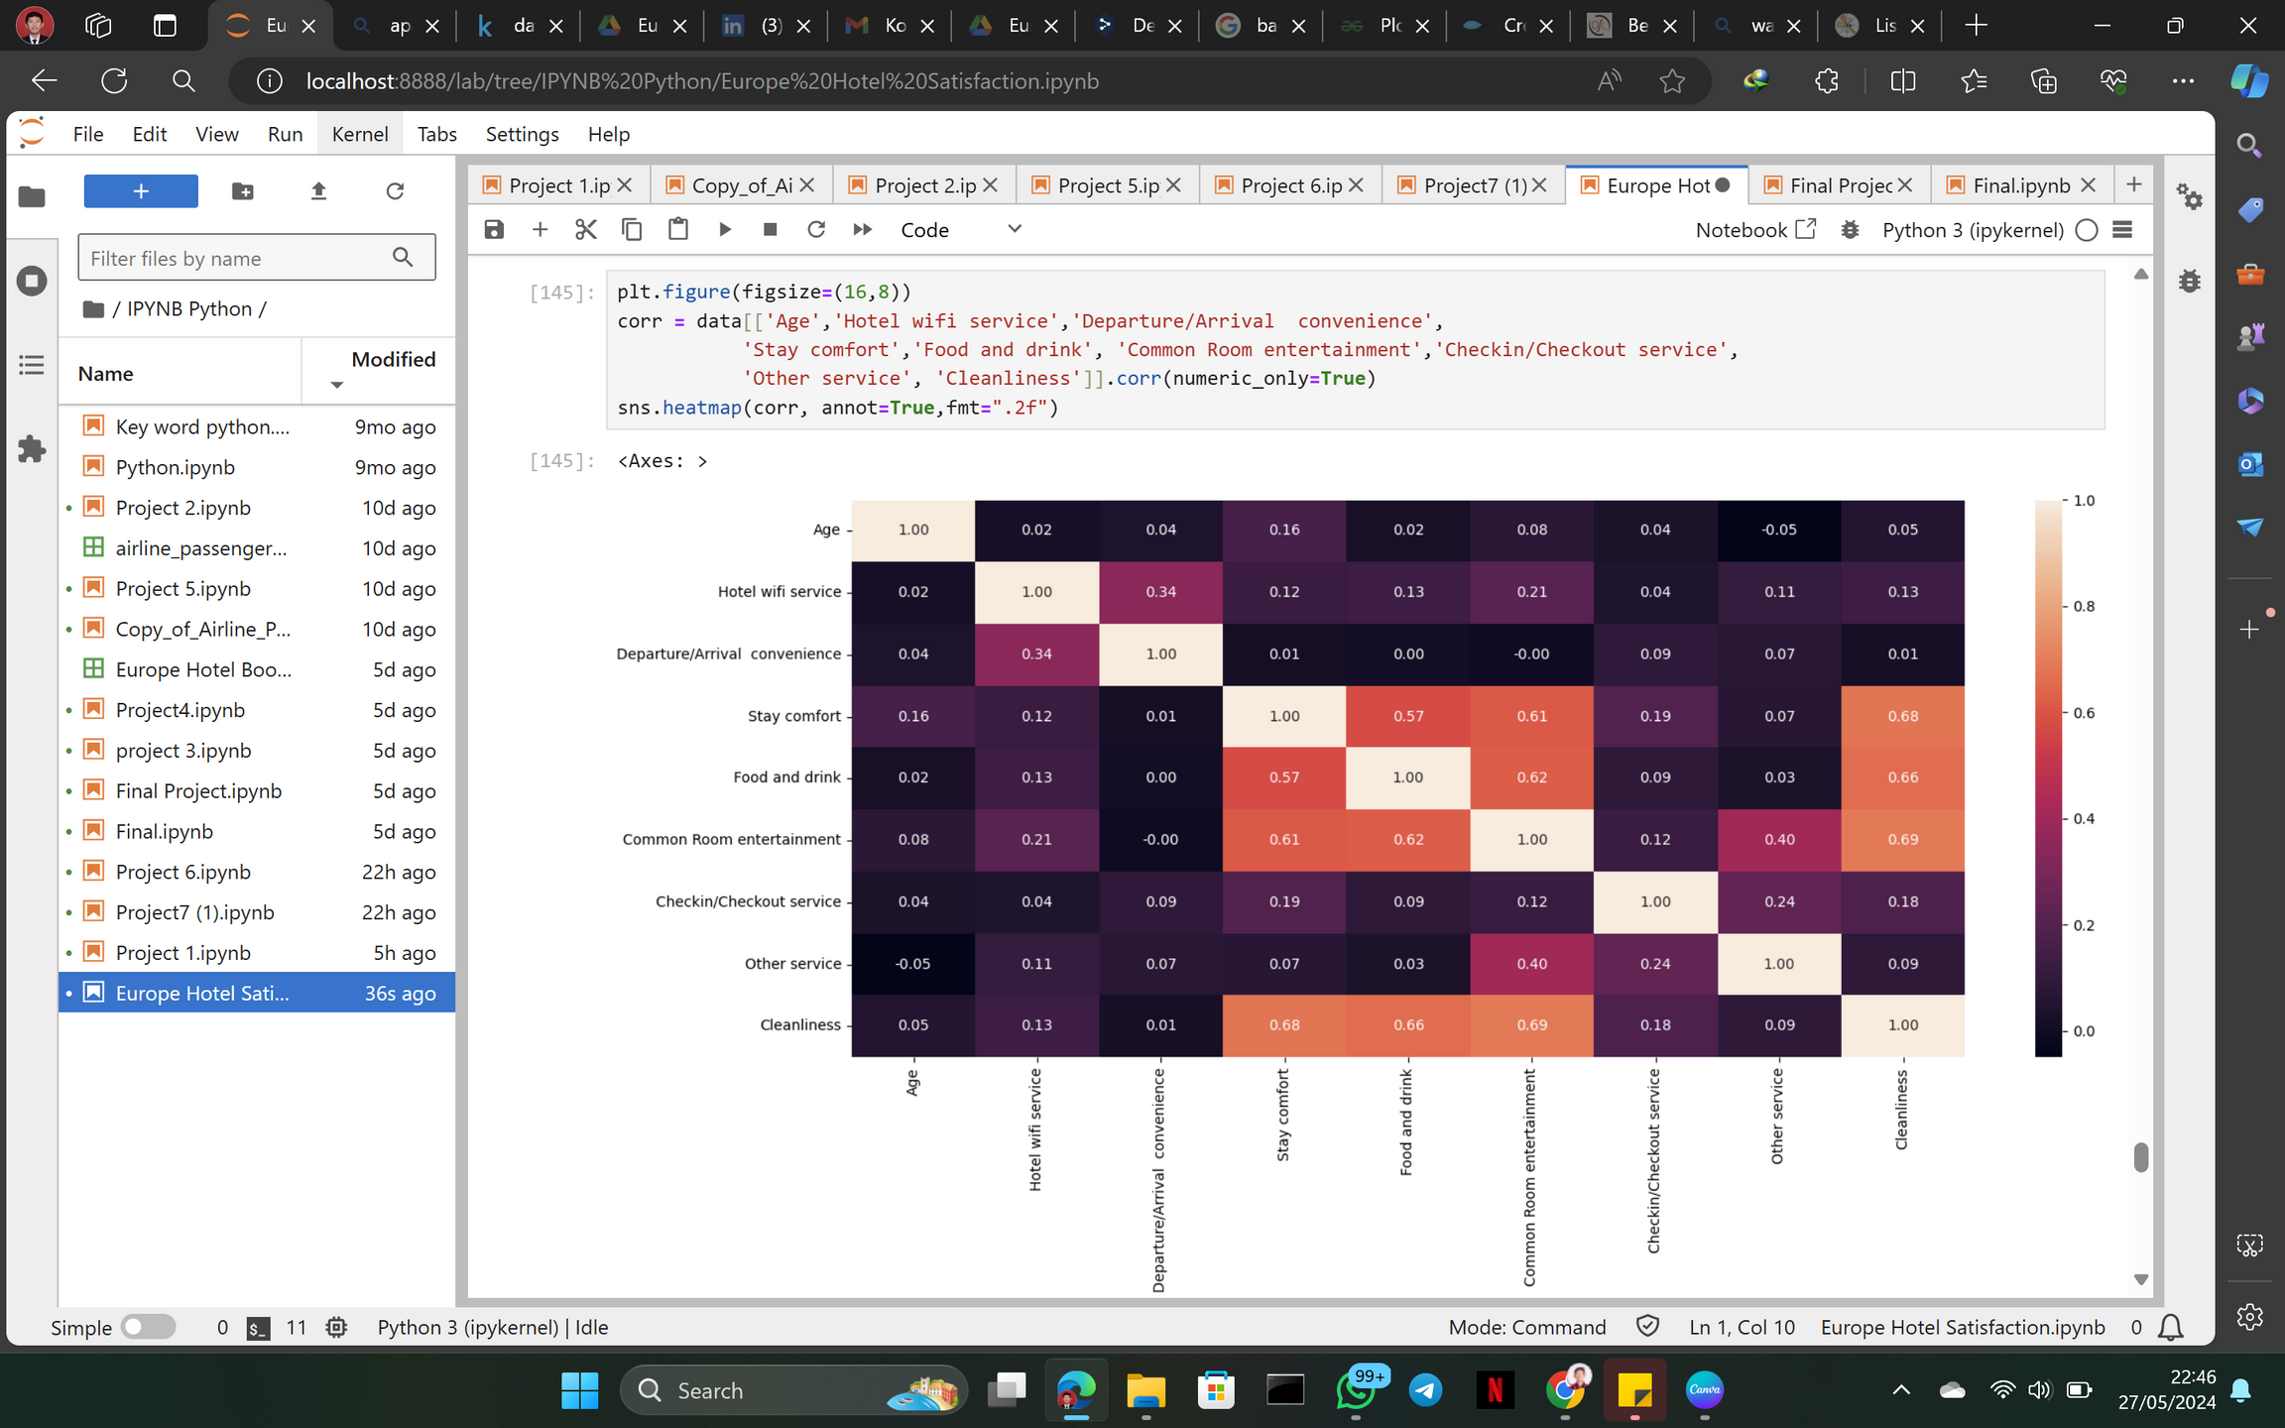
Corelation heat map
Light or intense colors indicate high values for the relationship between columns, while dark colors indicate low values.

Slide 21

THANK YOU

